Slide 1


Early Education Center 2025-2026

Slide 2
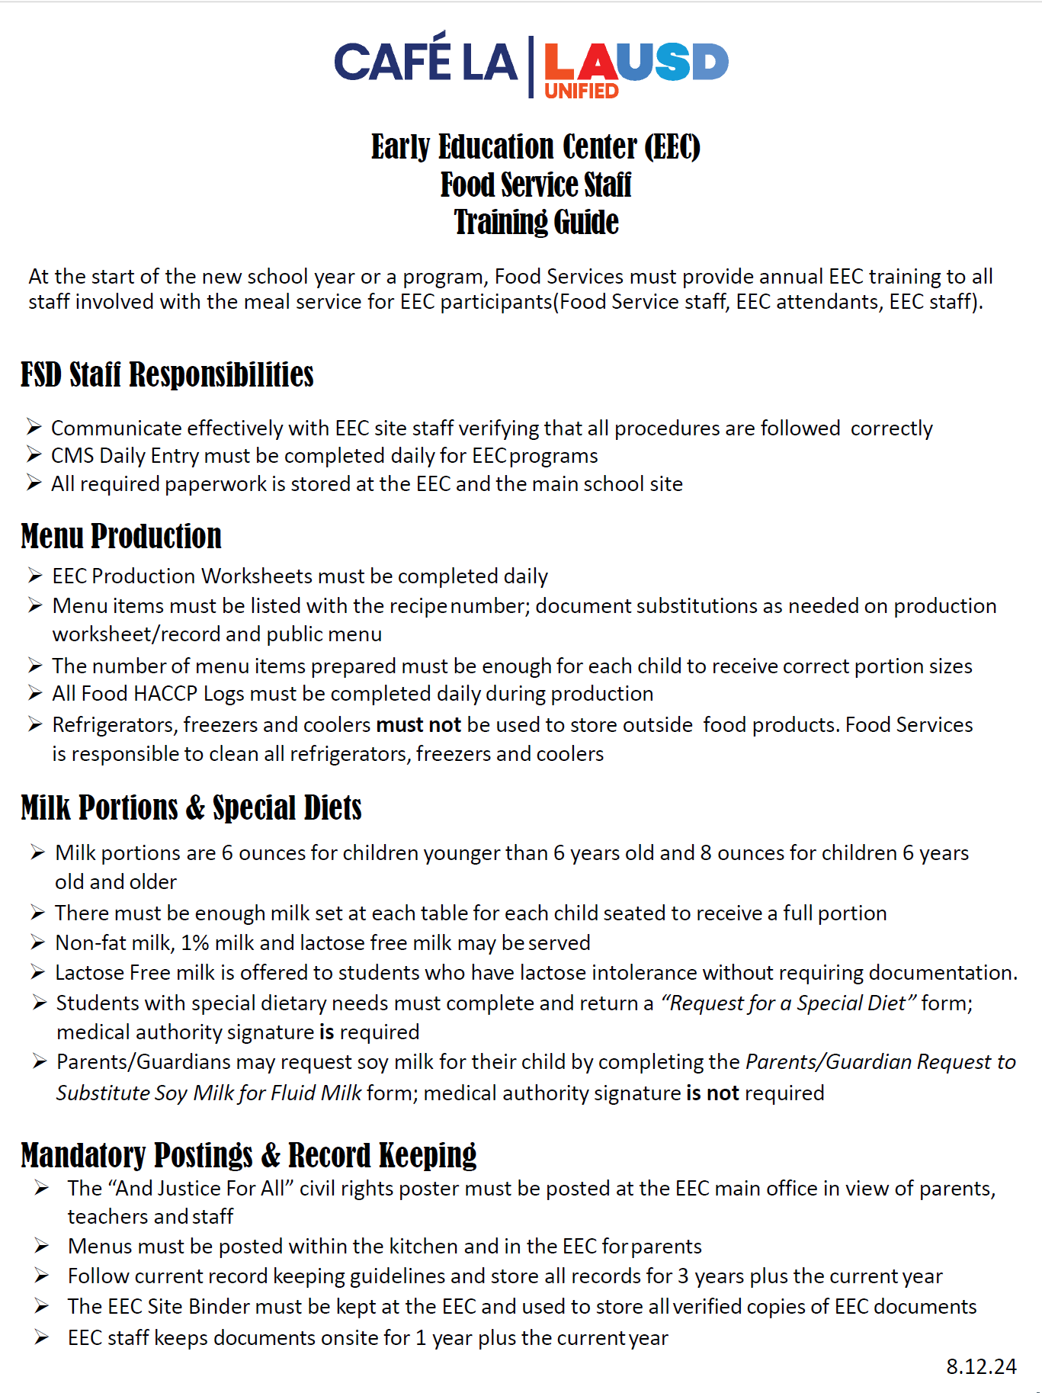
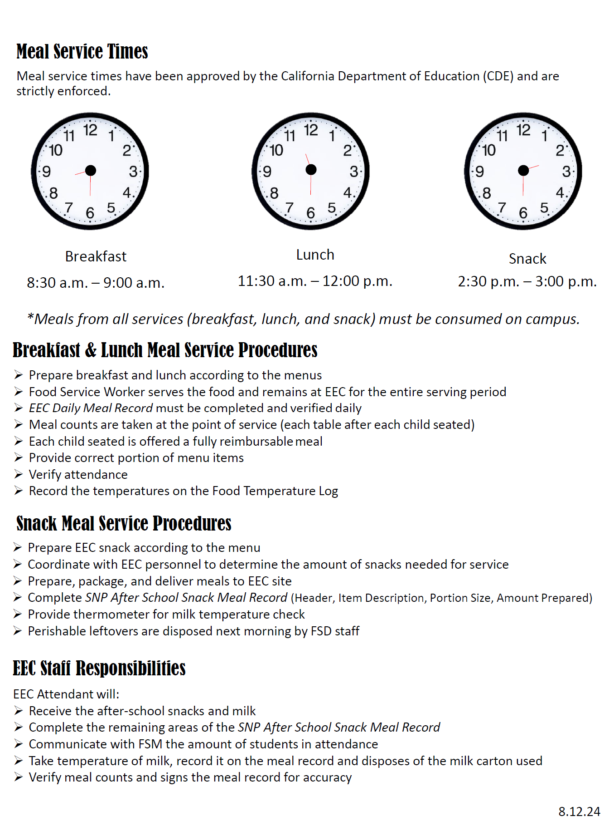
Training Requirements for FSD Staff
  At the start of the new school year or a new program, FSD must provide annual EEC training to all staff.
  Use the EEC Food Services Staff Training Guide to train your staff that serve the EEC students

Slide 3
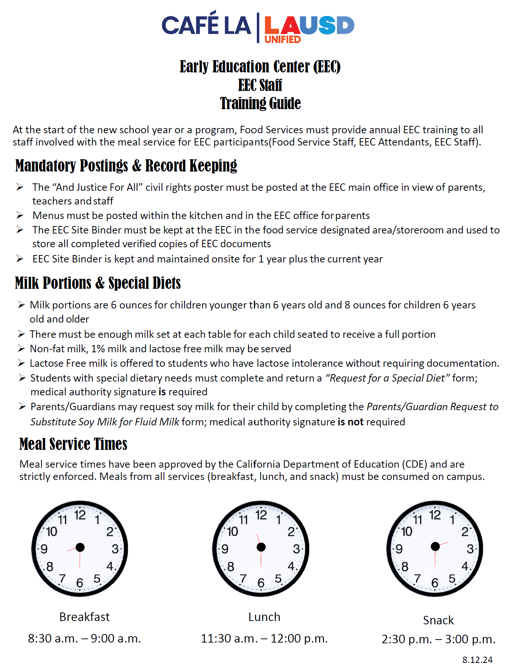
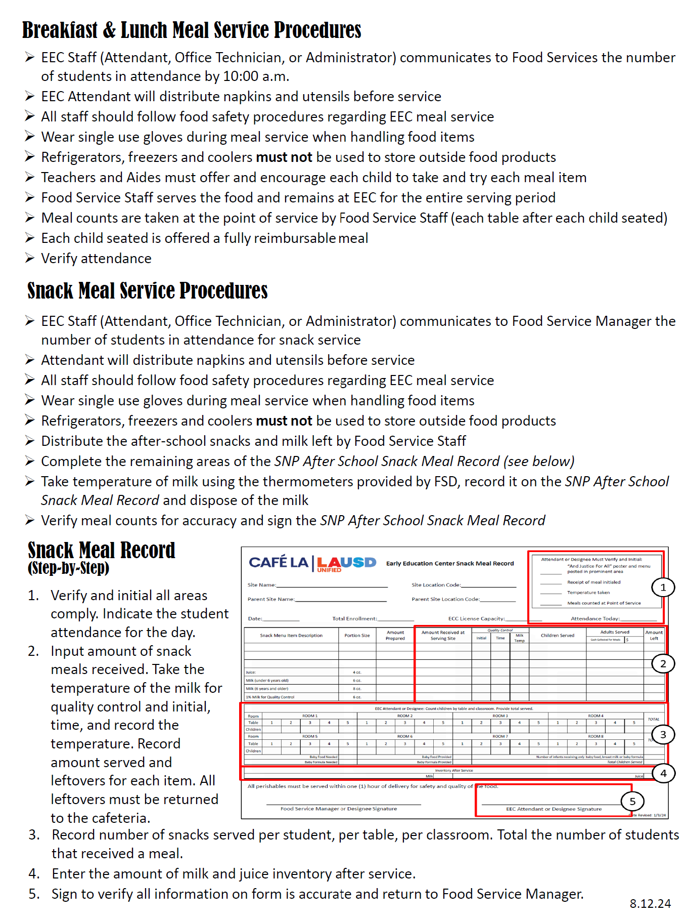
Training Requirements for EEC Staff
  It is the responsibility of the Food Service Manager to ensure that all EEC Staff who assist in the serving of EEC students are trained.
  Use the EEC Staff Training Guide to assist in training the EEC Attendant and/or Designee at the site of their roles and responsibilities of the meal program
  Provide them with a copy

Slide 4
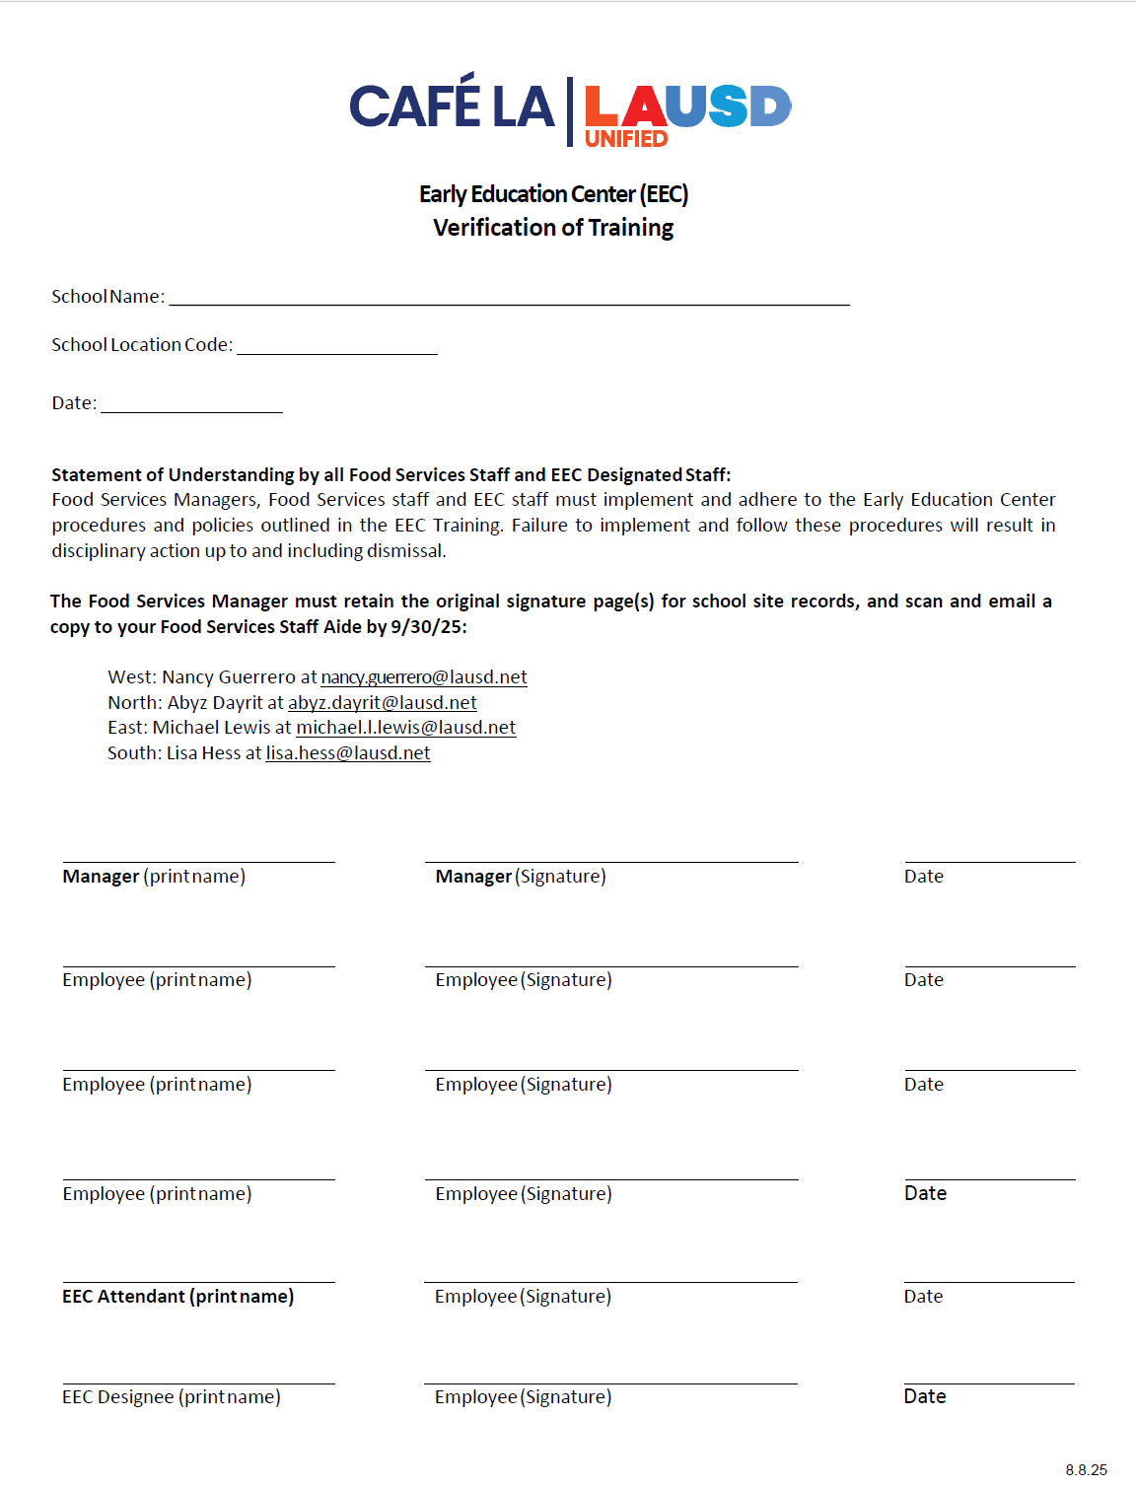
EEC Staff Training Verification
    The Food Service Manager will verify the current EEC Attendant and/or Designee has a training verification on file:
      Communicate with the EEC administrative assistant
      Follow up with appropriate training measures as needed

Slide 5
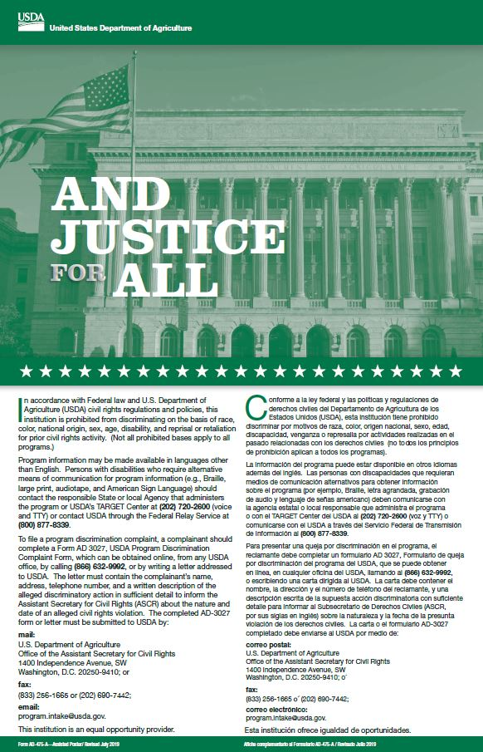
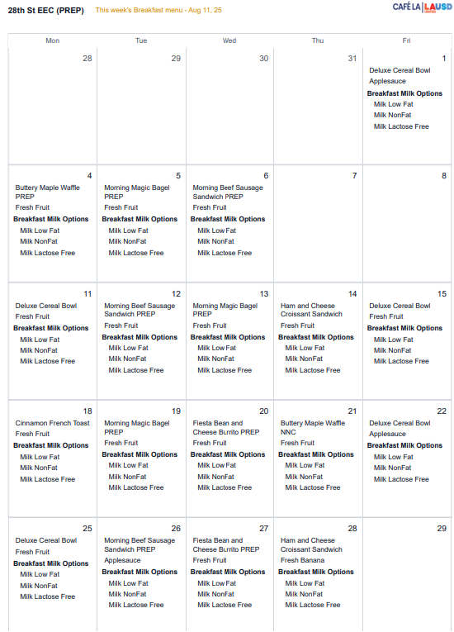
Mandatory Postings
  The USDA requires mandated postings be prominently displayed in view of the parents, EEC staff, and children.
“And Justice for All” poster
Current Menus

Slide 6
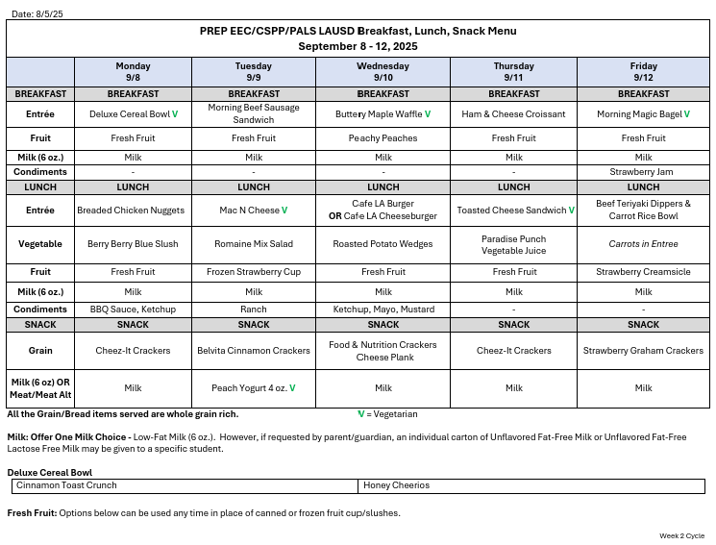
EEC Menu
  The EEC menu is located on the “Menu” tab of the Café LA website.
  Choking hazard accommodations for preschool students are already included in the EEC menu
  Refer to the 2025-2026 Menu Contribution List when substitutions are necessary
  Cross out the item that is substituted and write in the new item being served

Slide 7
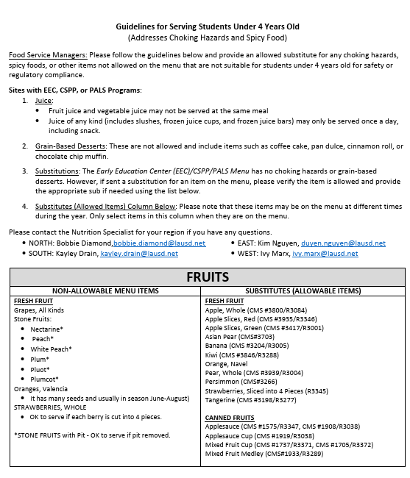
Guidelines for Serving Students Under 4
  There are guidelines that allow substitutions to be made for any choking hazards, spicy foods, or other items not allowed to be served to students under 4 years old.
  These guidelines are located on the “Menu” tab of the Café LA website under Menu Resources.

Slide 8
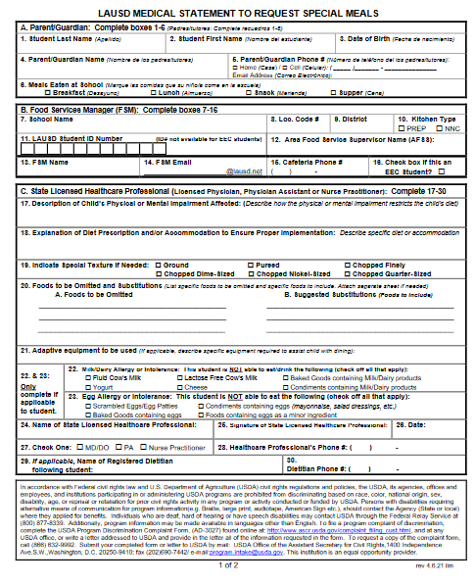
Requesting Special Meals
The FSM will follow the “Procedures for Requesting Special Meals” for students not on file and requesting a special diet:
  FSM are to provide the “Medical Statement to Request Special Diets” to families for completion by the child’s treating physician.
  FSM will email the completed “Medical Statement to Request Special Diets” form to SpecialDiet@lausd.net
  FSM will make substitutions based on the special diet provided by the Nutrition Specialist.

Slide 9
Milk Requirements
Each child receives one 6 fluid ounce carton of milk to assure a full serving is offered when serving a reimbursable meal. The milk must be unflavored for students in grades kinder and below.
EEC MILK GUIDELINES (BREAKFAST, LUNCH & SNACK)
AGE | MILK TYPES ALLOWED
1 year until 2nd birthday | Whole milk unflavored
2 years and older | 1% unflavored (must serve) fat free unflavored (only serve upon parent request) lactose free unflavored (only serve upon parent request)

Slide 10
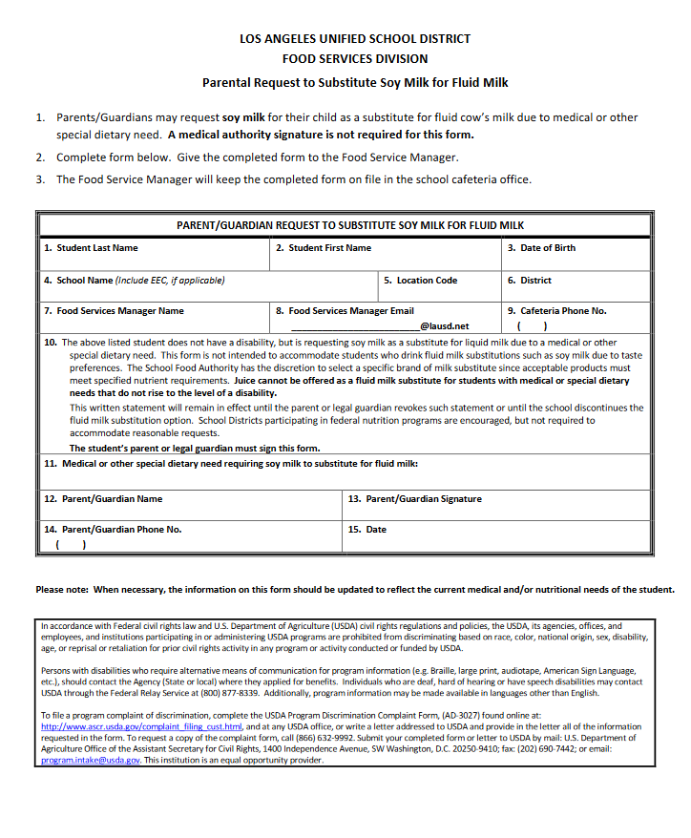
Procedure to Request Soy Milk
  Parents/Guardians may complete the “Parent/Guardian Request to Substitute Soy Milk for Fluid Milk” form and submit it to the School Food Service Manager.
  A medical authority signature is not required for the form.

Slide 11
Menu Questions?
Contact the menu team for any questions regarding menu items and hazards for EEC.
North Region – Bobbie Diamond (bobbie.diamond@lausd.net)
East Region – Kim Nguyen (duyen.nguyen@lausd.net)
South Region – Kayley Drain (kayley.drain@lausd.net)
West Region – Ivy Marx (ivy.marx@lausd.net)

Slide 12
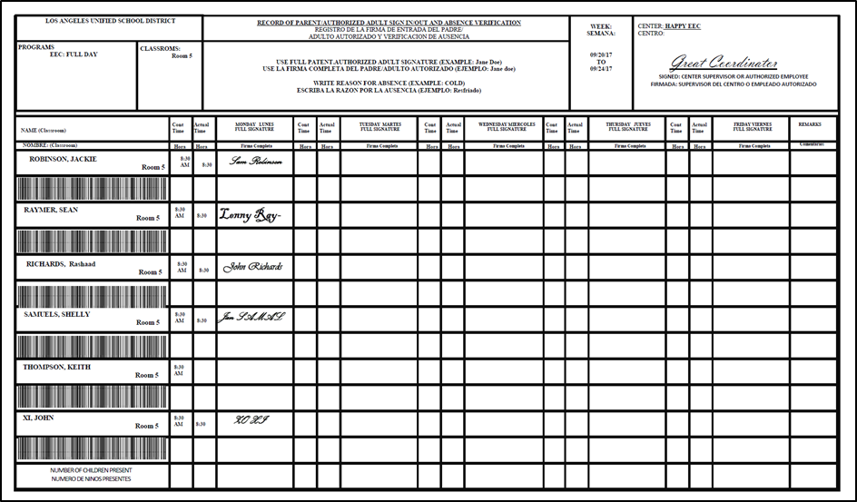
Attendance Records
EECs are required to maintain documentation on the attendance of each participant at the center.
Attendance records contain:
First and last name of child
Contract time
Sign in and sign out times
Parent/guardians signature
Reason for absence
Note: Students must be enrolled and in attendance for the FSD to receive reimbursement for meals claimed.

Slide 13
FSM Accountabilities
The FSM must complete:
EEC Weekly Compliance Checklist
Daily Meal Record (enter meal counts in CMS Daily Entry)
Snack Count Forms (enter meal counts in CMS Daily Entry)
HACCP Logs
Other duties:
Verify information is true and accurate on all documents by the attendance records (Notify the AFSS of discrepancies)
Provide the annual training for all Food Service Staff and EEC Staff on program procedures.

Slide 14
Verification of Meals Claimed
Food Services Staff is responsible for counting the number of children signed in on the daily attendance roster and comparing it to the number of meals served.
If parents/guardians do not sign in/out teachers or administrator will place a check mark on the sign in/out form to indicate the student is in attendance.
Each institution shall certify that the claim is correct and that records are available to support the claim.
Attendance counts will be entered in Newton FOH daily.

Slide 15
Meal Claim Discrepancies
If the attendance record does not support the meal count the FS Manager will bill EEC site for the discrepancy.
  The FSM is responsible for advising the EEC Office Personnel immediately
  If the discrepancy has not been resolved by the next day the meals will be billed to EEC Director.

Slide 16
Food
Safety

Slide 17
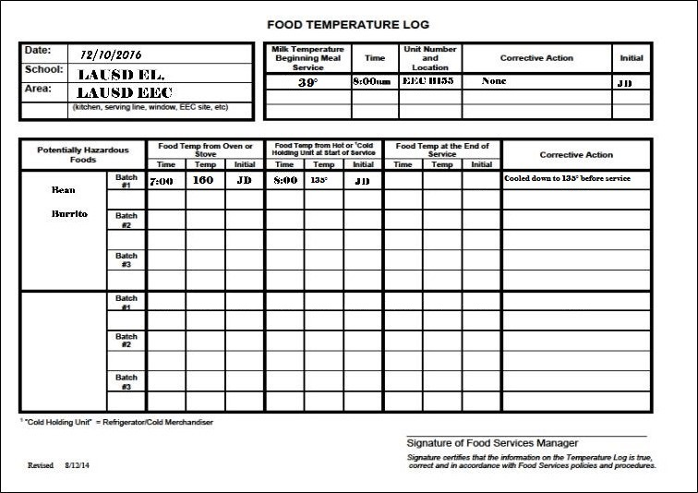
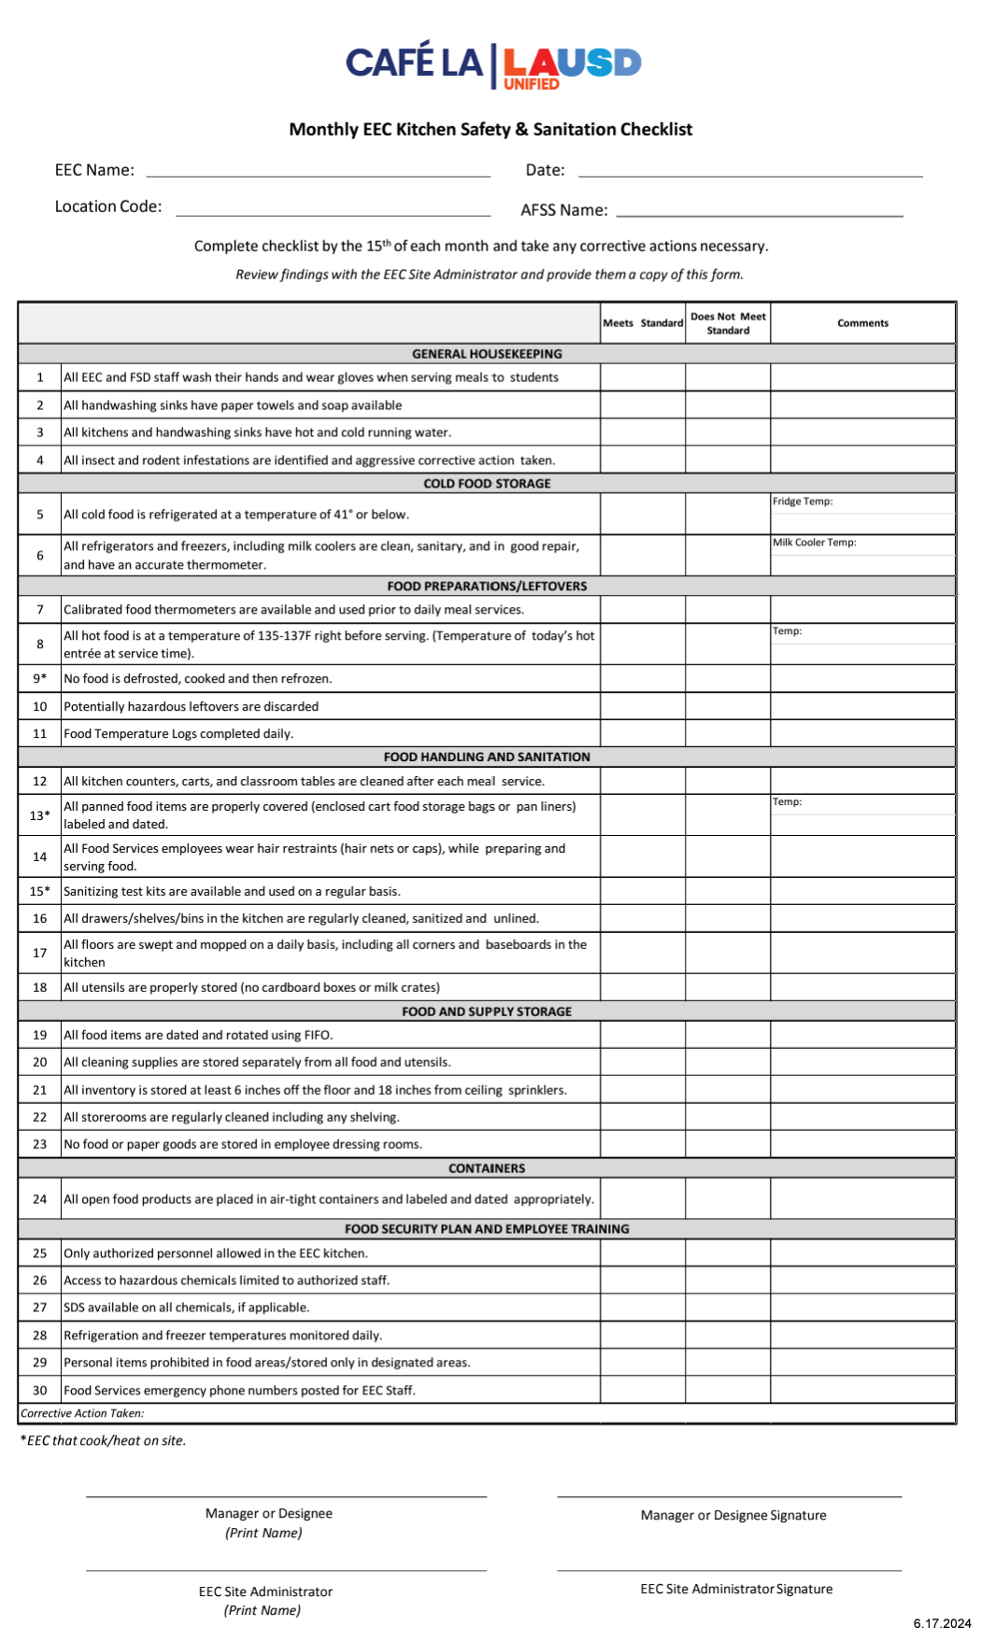
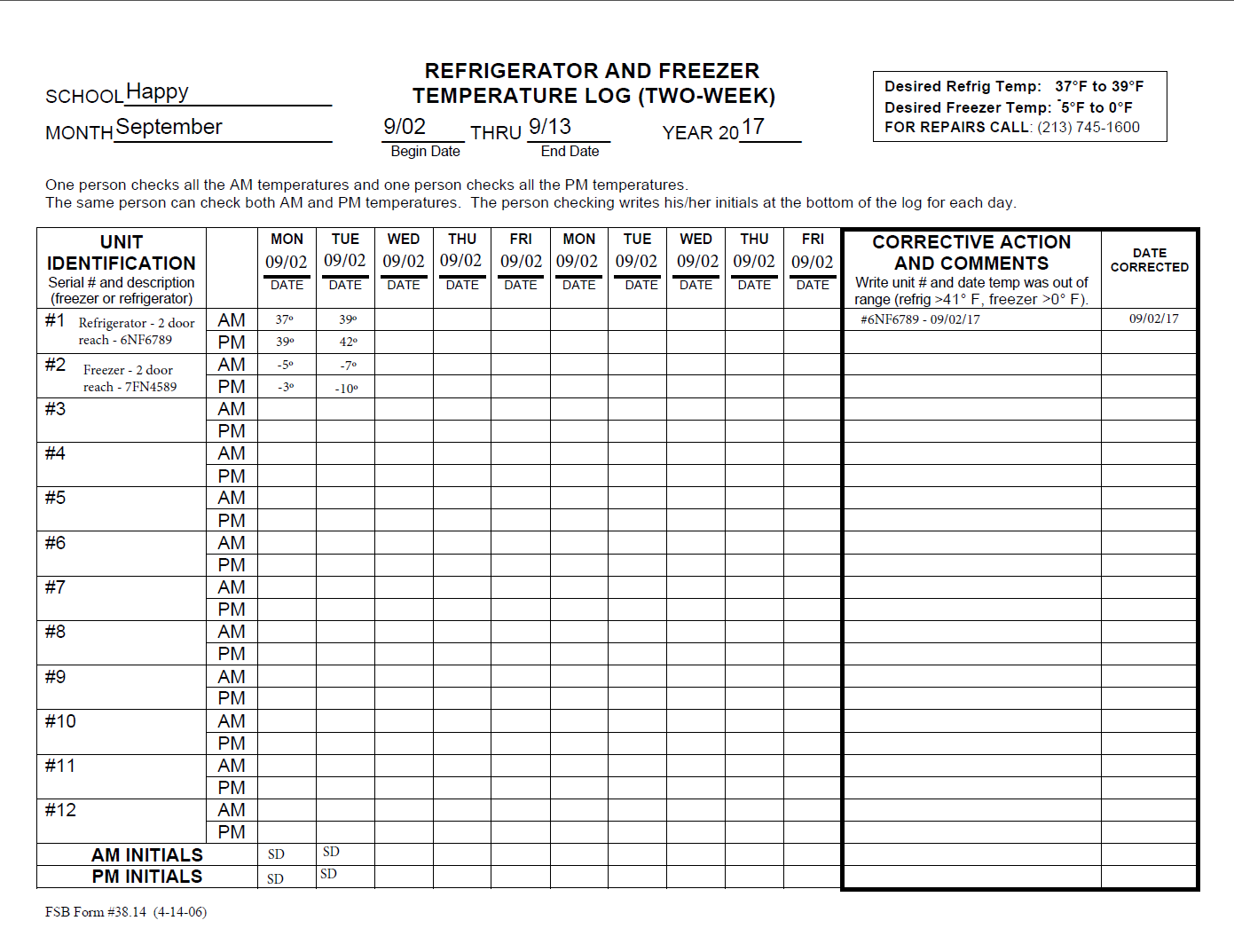
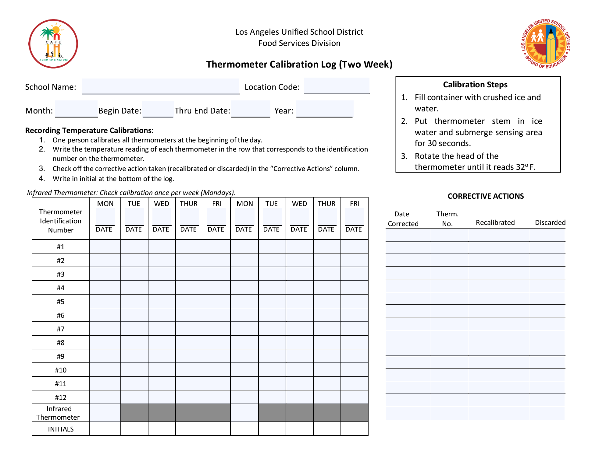
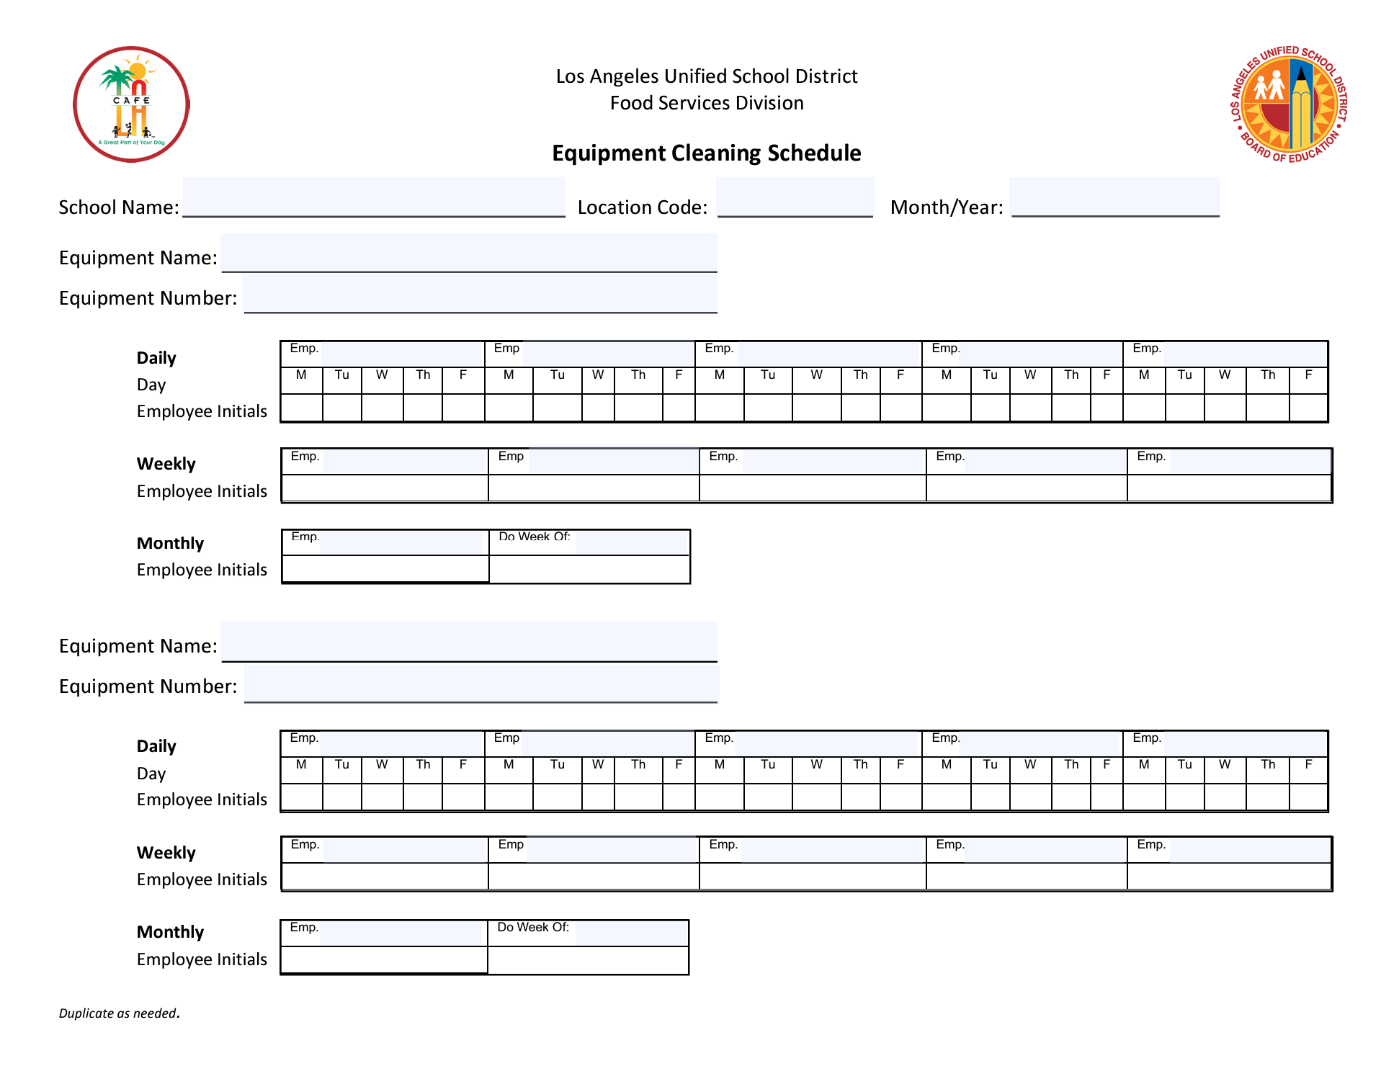
HACCP Procedures
To ensure the safety of the food, the following HACCP records are to be completed and maintained in the EEC binder:
Food Temperature Log
Refrigerator and Freezer Log
Thermometer Calibration Log
Equipment Temperature Log
Monthly EEC Kitchen & Safety Sanitation Checklist

Slide 18
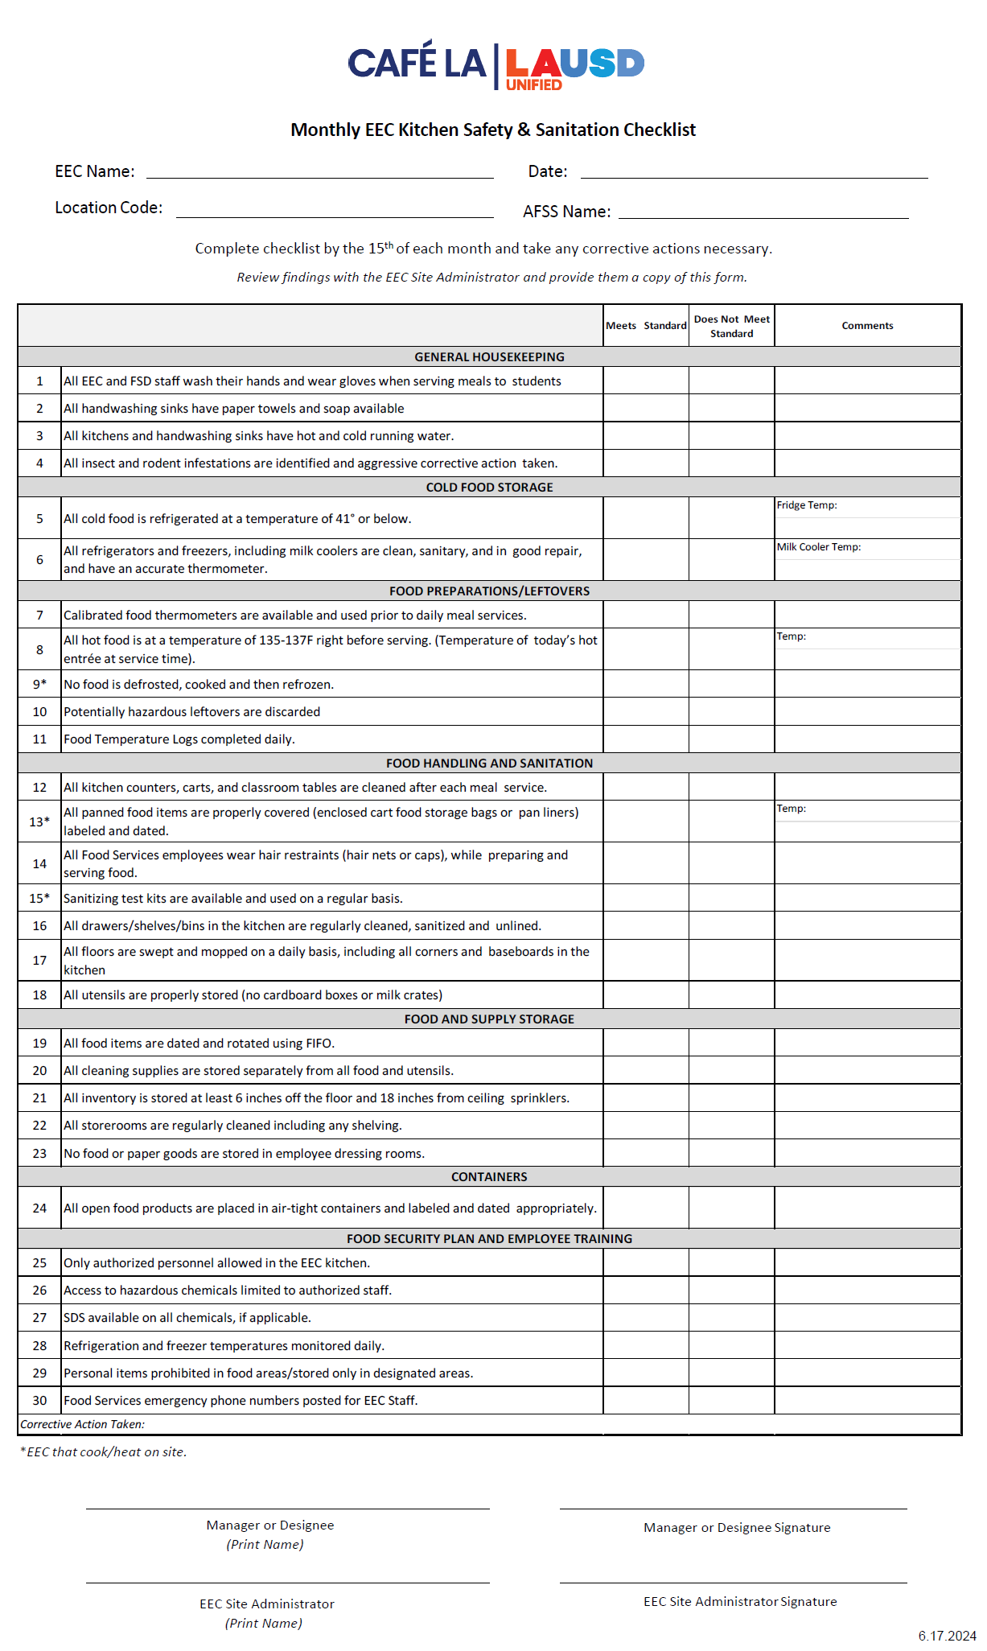
Monthly Sanitation Checklist
The EEC Kitchen Safety & Sanitation Checklist is completed by the 15th of each month
Take corrective action, if necessary
Review any findings with EEC Administrator
Provide a copy to EEC Administrator

Slide 19



Single Use Gloves
Whether it be Food Service Staff, EEC Attendant, Teacher or Aide, all must wear single-use gloves when handling food items and serving to students at the EEC.

Slide 20
Food Temperatures
Food safety is a primary concern in preschool aged children.
  Temperatures must be recorded during production, prior to and at the completion of each meal service
  The Food Temperature Log will be used at the main site and then transported with the food for completion
  Food Service staff is required to take the temperatures of the food, including milk
    For snack service, the EEC attendant takes the temperature of the milk prior to service
    Ensure a calibrated thermometer is provided

Slide 21

Serving Temperature for EEC Students
Hot food must be cooled before serving to students at EECs.
Temperature must be between 135 – 137 degrees.
Use insulated bags to ensure proper temperature control during transport

Slide 22
Counting & Claiming

Slide 23
Meal Count Forecasting
Determining the correct amount of food to prepare each day is important to avoid food waste.
  Breakfast counts are determined by using the Daily Meal Record history
  Before 10:00 a.m. daily, the EEC site staff will call the cafeteria with the attendance for the day
  Lunch count is based on the attendance count
  Snack amounts will be based on amount ordered by EEC staff

Slide 24
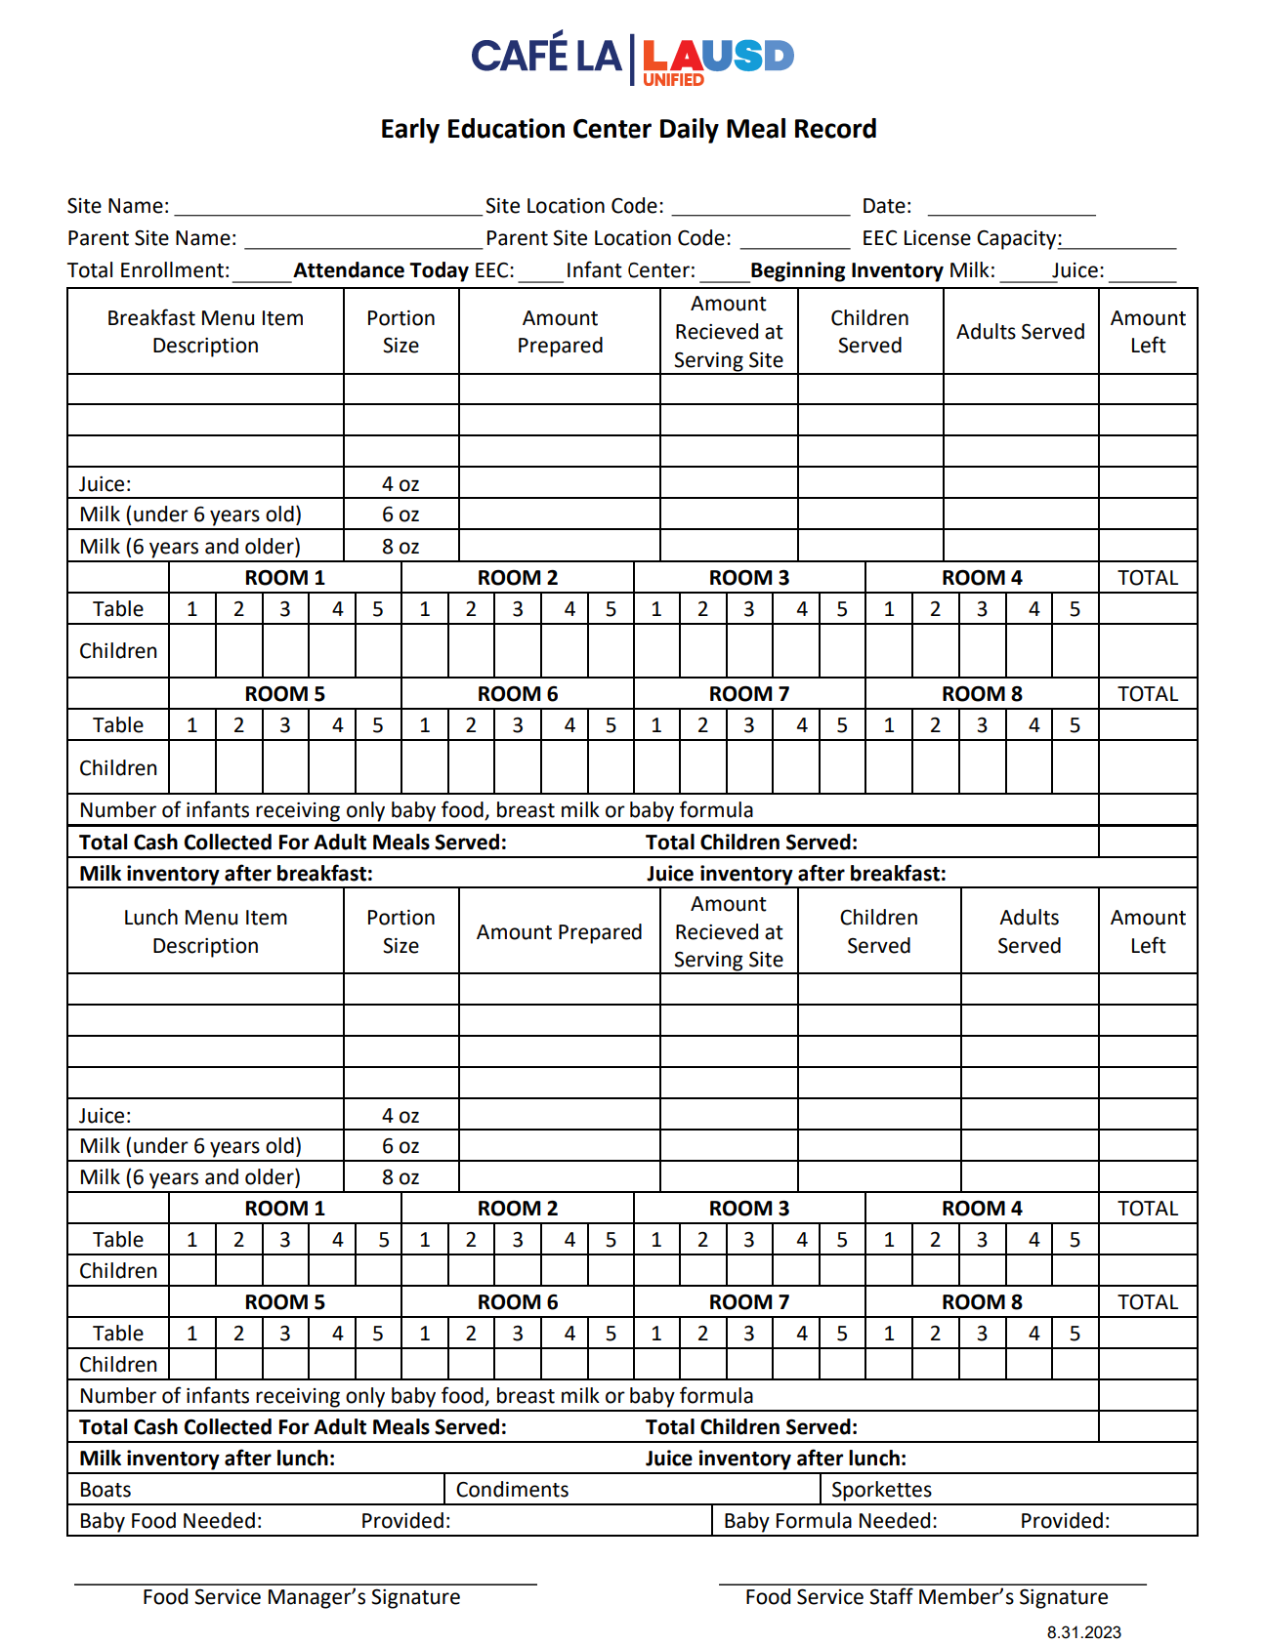
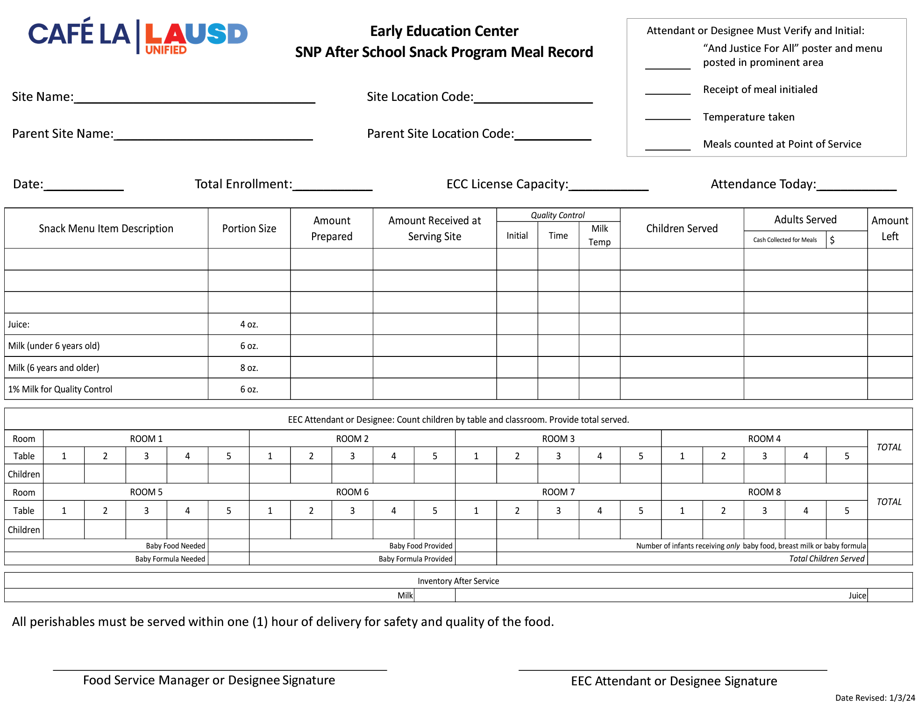
EEC Forms for Counting

Slide 25
Serving Menu Items
All menu items will be placed at each table based on the number of students that are seated at the table.
Staff should be aware of students that are not seated and make rounds to each classroom to ensure all had an opportunity to be served.
Use the appropriate counting form for each meal service.

Slide 26


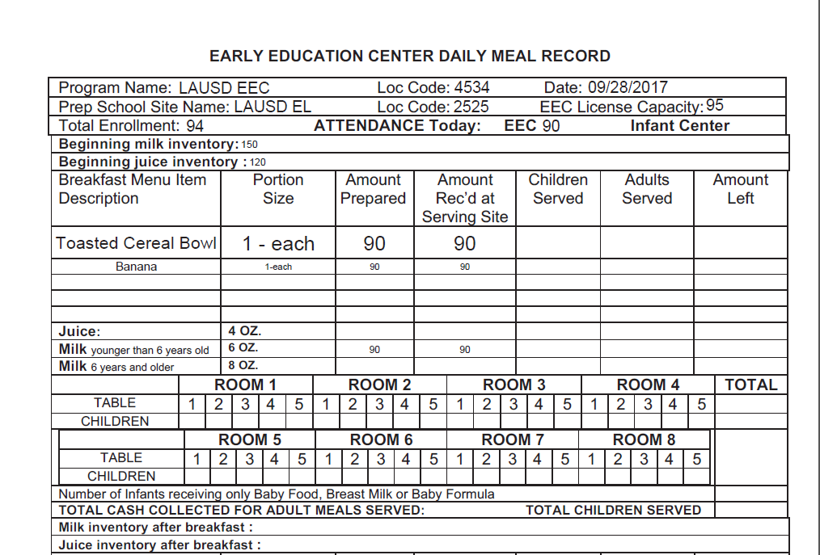

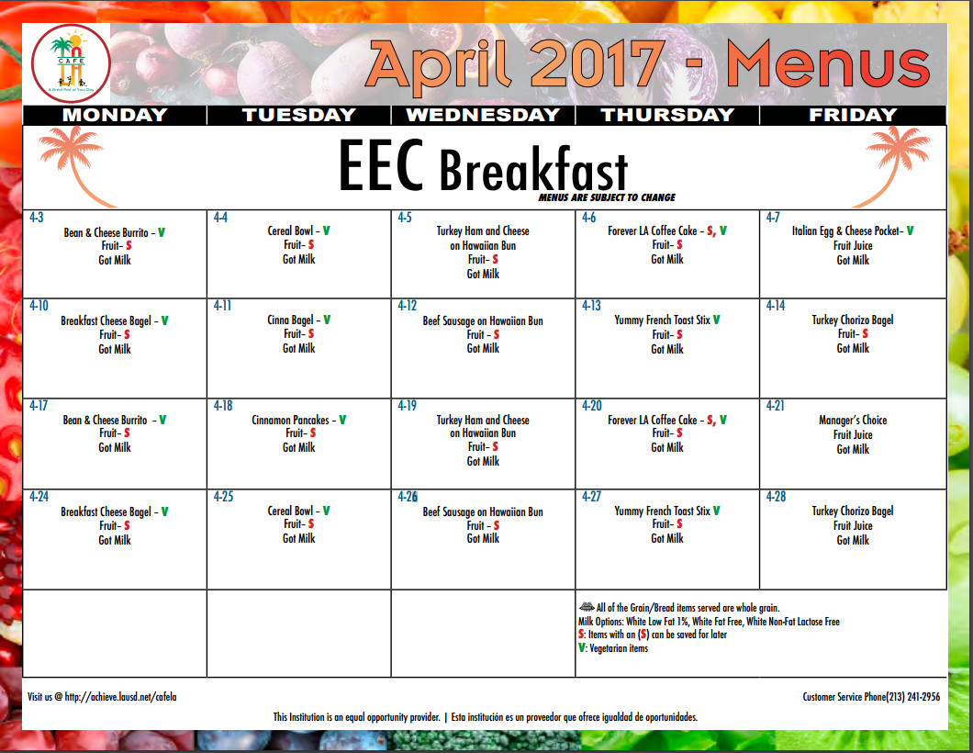
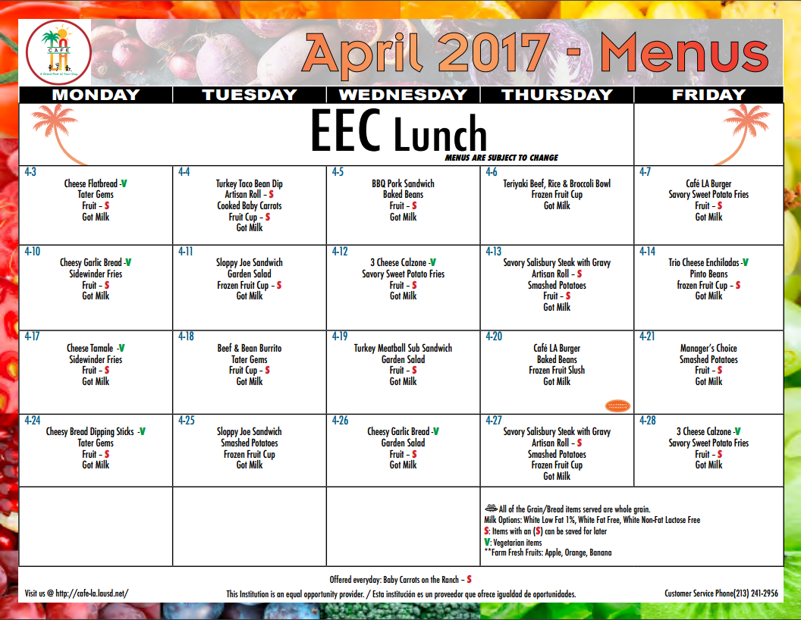











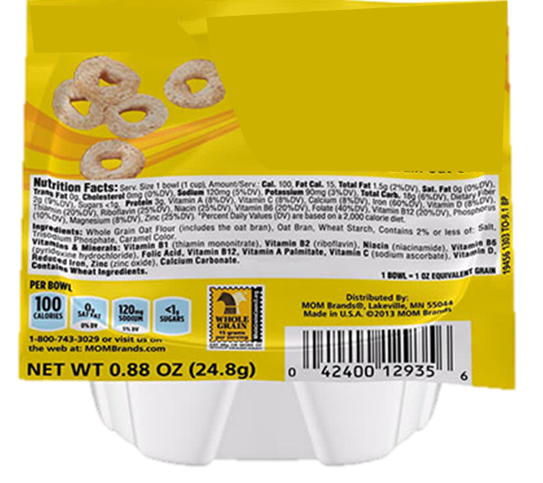





Count the students seated, ready to be served. Record it on the Daily Meal Record for that service.

Slide 27
Note: Scratch paper should not be used to keep track of meals being served to seated students at the table. If any corrections to a tables count must be made, make it on the aily meal record by crossing out and correcting the form.
6 7 5
6
Notes:
Read: In this classroom example we see the food service worker enter the EEC classroom and serving all items to seated students to complete a reimbursable meal. This process is continued for each table and each room until the serving period has ended. If any corrections to a table count must be made, the correction must be made on the daily meal record. The use of scratch paper or other forms are not allowed to record meals being served.

Slide 28
Note: Scratch paper should not be used to keep track of meals being served to seated students at the table. If any corrections to a tables count must be made, make it on the Daily Meal Record by crossing out and correcting the form.
6 7 5
6
Notes:
Read: In this classroom example we see the food service worker enter the EEC classroom and serving all items to seated students to complete a reimbursable meal. This process is continued for each table and each room until the serving period has ended. If any corrections to a table count must be made, the correction must be made on the daily meal record. The use of scratch paper or other forms are not allowed to record meals being served.

Slide 29
The students playing on the carpet would not be served at this time.

Slide 30

FSD staff should check each room for any additional students requiring a meal
Unfortunately, students arriving after the approved service time may not be served

Slide 31
Real World Service
Interruptions and non-seated students are a reality of meal service for EECs. Food Service Staff should be familiar with the correct processes for serving meals when conditions are less than ideal.
Menu items cannot be left at the table at the time of service for:
  Students in the restroom
  Late arriving students
  Students playing and not seated

Slide 32
Claiming for Reimbursement
FSD collects claiming information from Newton FOH. There are two key areas in Post Operating Day that must be filled out to claim EEC meals:
    Misc Counts
    Daily Figures

Slide 33

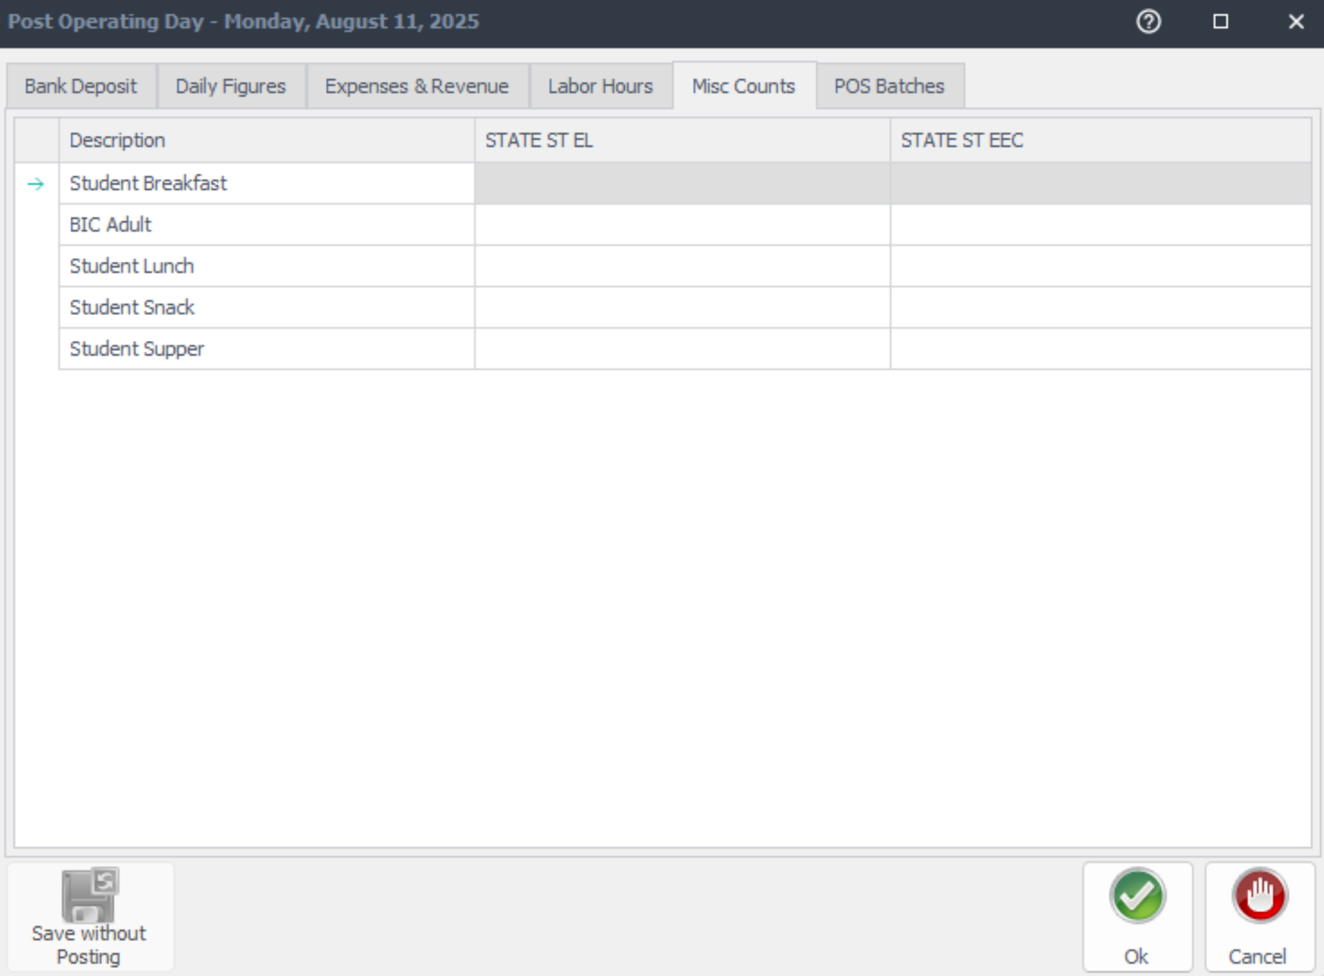
Misc Counts in Post Operating Day
To account for all EEC meals served to students, FSD staff will record the amount in Newton Post Operating Day.
Click on the MISC Counts tab, select the EEC site, and input number of meals served for:
Breakfast
Lunch
Snack

Slide 34
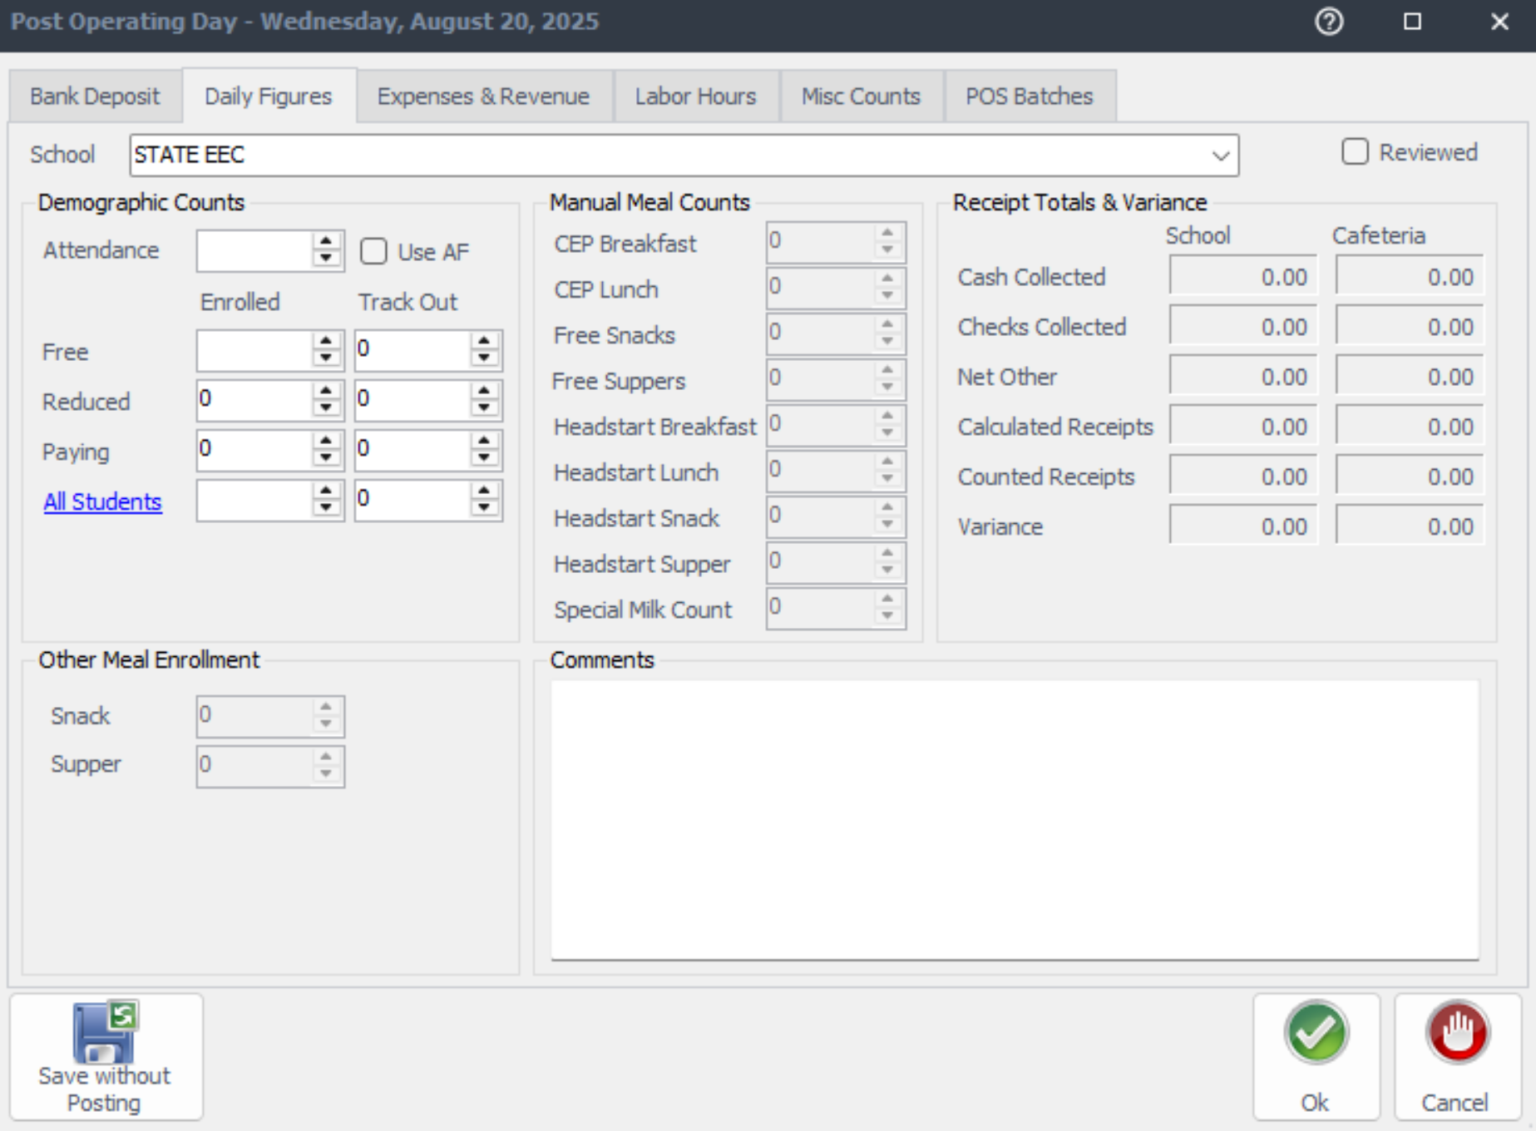
Daily Figures in Post Operating Day
  Complete the following under Demographic Counts:
    Verify attendance from the Daily Meal Record and input accurate number of students
    Enter the number of students enrolled at the EEC under Free
    Reduced and Paying amounts stay at 0
    Click Reviewed

Slide 35
Café Fiscal Staff Role
  Café fiscal staff will review the Edit Check Report to confirm the following:
    Enrollment supports meal count
    License capacity does not exceed the meals served
    Compile the total number of participants
    Calculate the average Daily Meal Participation
    Submit to CDE to claim Meal Reimbursement after necessary adjustments

Slide 36
Breakfast
Service

Slide 37
Meal Service Time for Breakfast
The meal service times have been approved by the California Department of Education (CDE) and therefore must be strictly enforced.
Breakfast Service
8:30 a.m. – 9:00 a.m.

Slide 38
Meal Patterns for Breakfast
EEC BREAKFAST
COMPONENT | DAILY REQUIREMENT
GRAIN, OZ. EQV. AND/OR GRAIN & MEAT/MEAT ALT, OZ. EQV. | 1
FRUIT, CUP | 1/2
MILK | 6 FL OZ
FRUIT & VEGETABLE JUICE | EEC
VEGETABLE JUICE | May serve juice once per day. If juice is served for breakfast, it cannot be served at lunch or snack.
FRUIT JUICE

Slide 39
Meal Service for Breakfast
Pre-Service
EEC Attendant places napkins, utensils, and condiments on table
During Service
FS Staff will serve all menu items per student seated for each classroom
Post-Service
EEC Staff wipes down tables and throws away all trash

Slide 40
Breakfast Service Procedures
A Food Service Worker will serve the food and remain at EEC for the entire serving period.
  Menu items served to only children seated
  Provide correct portion of menu items
  Meal counts taken at each table as it is served
  Verify attendance
  Record the temperatures on the Food Temperature Log

Slide 41
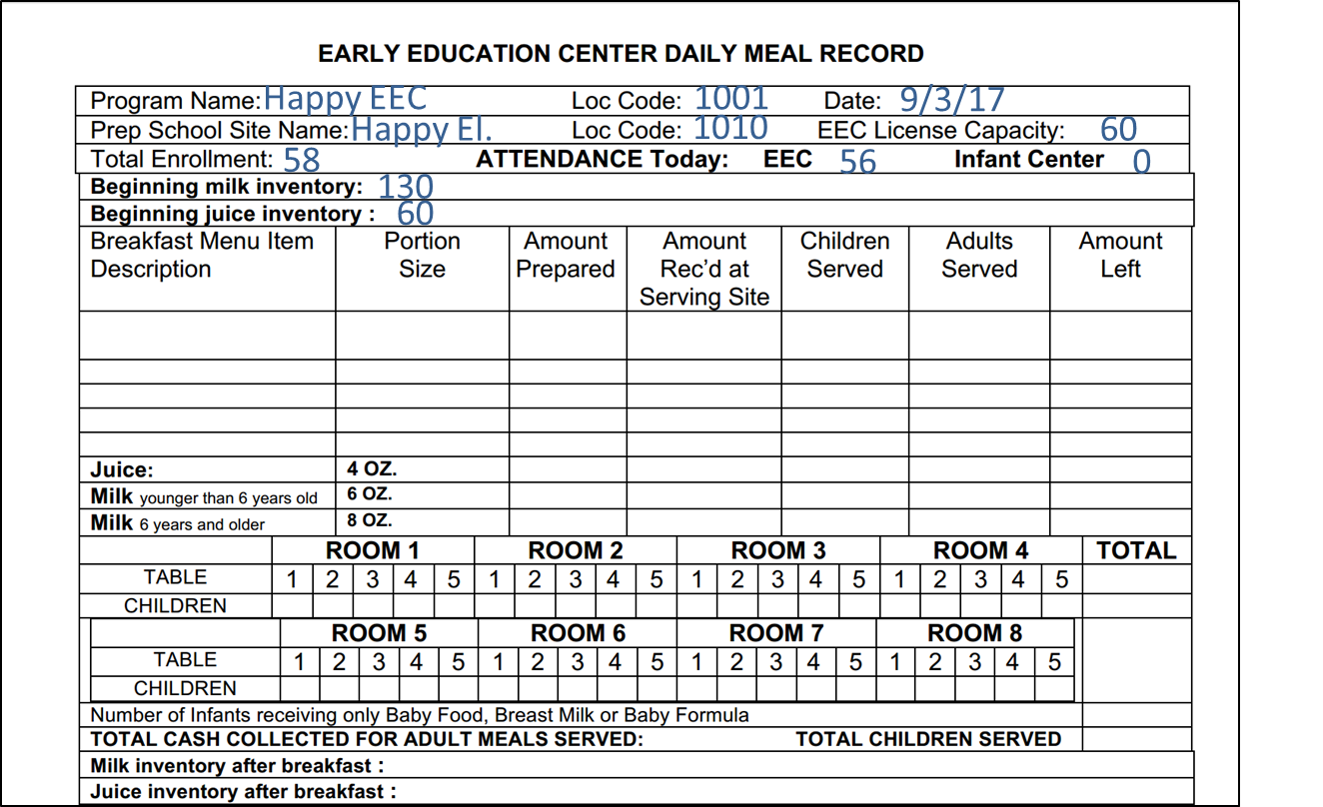
EEC Daily Meal Record - Breakfast
Toasted Cereal Bowl
1- each
58
58
56
0
2
Banana
1- each
58
58
56
0
2
1- each
58
58
56
0
2
7
8
7
7
6
7
7
7
56

Slide 42
EEC Daily Meal Record - Breakfast
Toasted Cereal Bowl
1- each
58
58
56
0
2
Banana
1- each
58
58
56
0
2
1- each
58
58
56
0
2
7
8
7
7
6
7
7
7
56

Slide 43
After Breakfast Meal Service
At the conclusion of the meal service, the Food Service Worker will count all remaining leftovers.
  Return leftovers to the main site
  Count and document the amount of leftovers on the appropriate form
The temperatures will be taken at the end of service and recorded on the Food Temperature Log.
  Properly dispose of any perishable leftover menu items

Slide 44
Lunch Service

Slide 45
Meal Service Time for Lunch
The meal service times have been approved by the California Department of Education (CDE) and therefore must be strictly enforced.
Lunch Service
11:30 a.m. – 12:00 p.m.

Slide 46
Meal Pattern for Lunch
EEC LUNCH
COMPONENT | DAILY REQUIREMENT
GRAIN, OZ. EQV. | 1/2
MEAT/MEAT ALT, OZ. EQV. | 1½
FRUIT, CUP | 1/4
VEGETABLE, CUP | 1/4
MILK | 6 FL OZ
FRUIT & VEGETABLE JUICE | EEC
VEGETABLE JUICE | May serve juice once per day. If juice is served for lunch, it cannot be served at breakfast or snack.
FRUIT JUICE

Slide 47
Meal Service for Lunch
Pre-Service
EEC Attendant places napkins, utensils, and condiments on table
During Service
FS Staff will serve all menu items per student seated for each classroom
Post-Service
EEC Staff wipes down tables and throw away all trash

Slide 48
Lunch Service Procedures
A Food Service Worker will serve the food and remain at EEC for the entire serving period.
  Menu items served to only children seated
  Provide correct portion of menu items
  Meal counts taken at each table as it is served
  Verify attendance
  Record the temperatures on the Food Temperature Log

Slide 49
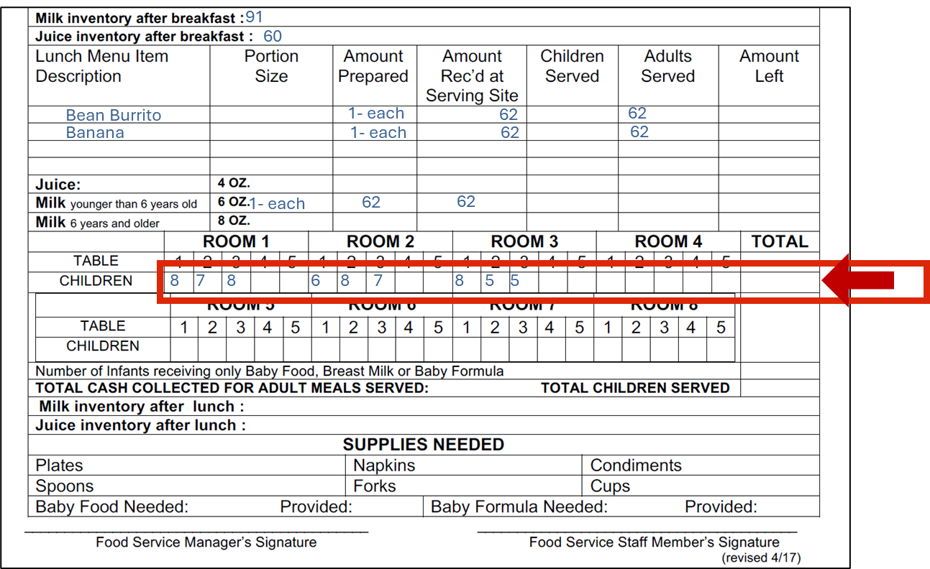
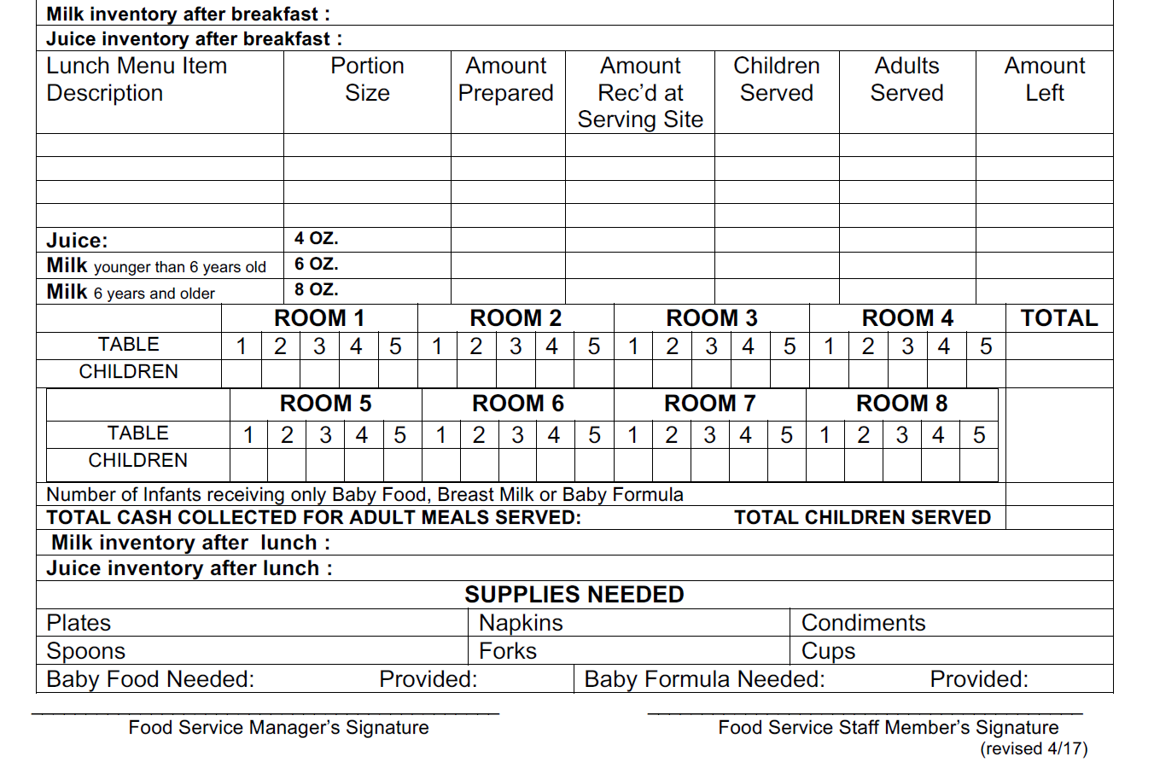
91
60
Bean Burrito
1- each
62
62
Banana
1- each
62
62
1- each
62
62
7
8
7
5
8
6
8
8
5
The serving process for each room and table remains the same as breakfast.

Slide 50
Once the children served are totaled, complete the service figures in both sections of the form.
91
60
Bean Burrito
1- each
62
62
62
0
0
Banana
1- each
62
62
62
0
0
1- each
62
62
62
0
0
7
8
7
7
8
5
5
62

Slide 51
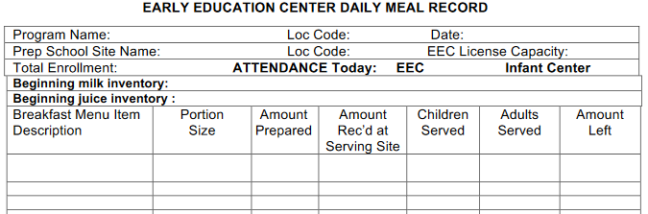
At the end of service, the food service employee will take an inventory of all EEC items and document supplies needed for the next service.
56
29
60
1
1
At the end of service, the food service employee will confirm the daily attendance at the EEC and document the attendance count.

Slide 52
The Food Service Worker will sign the form and return the completed form to the Food Service Manager for revision and signature.
Daeney Dandy

Slide 53
After School
Snack Service

Slide 54
SNP After School Snack
SNP After School Snack offers reimbursement to schools serving nutritious snacks to children participating in after-school care programs.
After-school snacks provide children with nutrition during after-school care and enhance their learning abilities by contributing to their physical and mental well-being.

Slide 55
Meal Service Time for Snack
The meal service times have been approved by the California Department of Education (CDE) and therefore must be strictly enforced.
Snack Service
2:30 p.m. – 3:00 p.m.

Slide 56
Meal Pattern for Snack
EEC SNACK
COMPONENTS | DAILY REQUIREMENT Must Serve 2 of the 5 Components
GRAIN, OZ. EQV. | 1/2
MEAT/MEAT ALT, OZ. EQV. | 1/2
FRUIT, CUP | 1/2
VEGETABLE, CUP | 1/2
MILK | 4 FL OZ
FRUIT & VEGETABLE JUICE | EEC
VEGETABLE JUICE | May serve juice once per day. If juice is served for snack, it cannot be served at breakfast or lunch.
FRUIT JUICE

Slide 57
Meal Service (Snack)
Pre-Service
EEC Attendant places napkins, utensils, and condiments on table
During Service
EEC Attendant serves menu items per student seated for each classroom
Post-Service
EEC Staff wipes down tables and throws away all trash

Slide 58
Snack Meal Service
The Food Service staff prepares the snack according to the Snack Menu.
  Food Services will coordinate with EEC staff to determine the amount of snacks needed for service
  Food Services will prepare, package and deliver meals to EEC site
  Food Services will complete the header portion of the EEC SNP After School Snack Meal Record
  Food Services will provide thermometer for milk temperature check

Slide 59


FSD Snack Preparation
Place snack items into a bag for each room. The amount of snacks provided is based on the verified attendance amount.

Slide 60
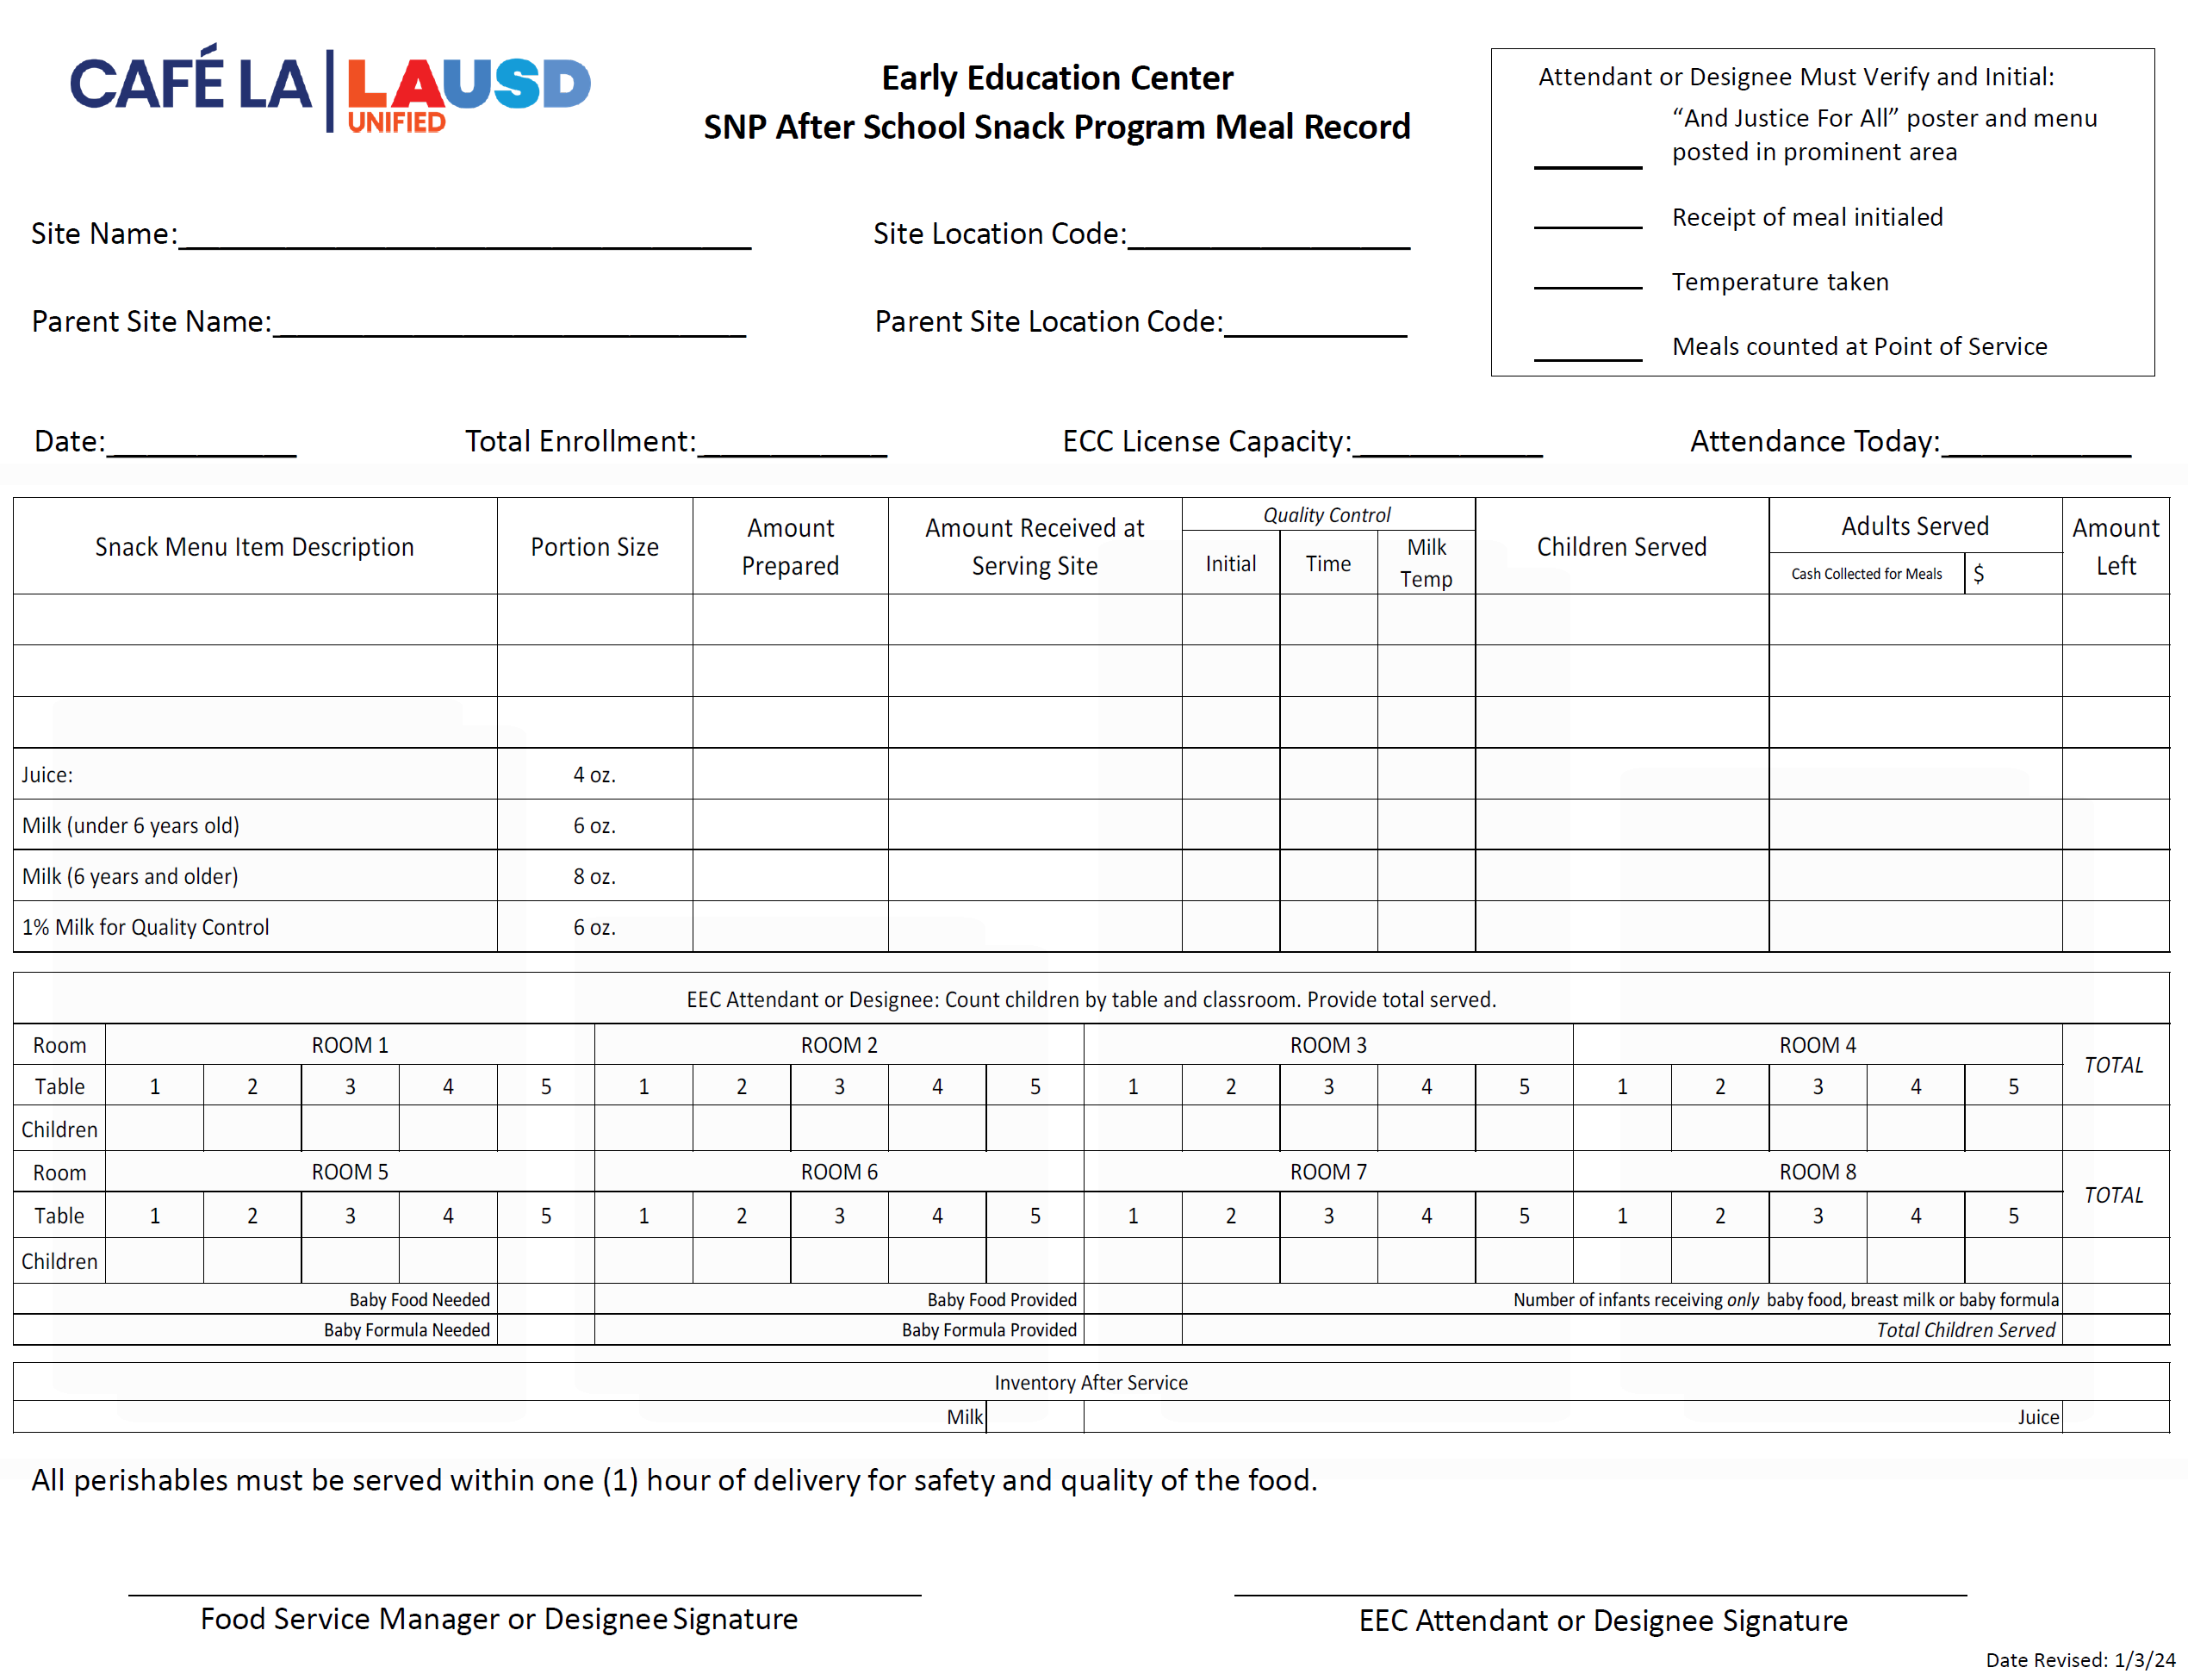
SNP Snack Program Meal Record

Slide 61
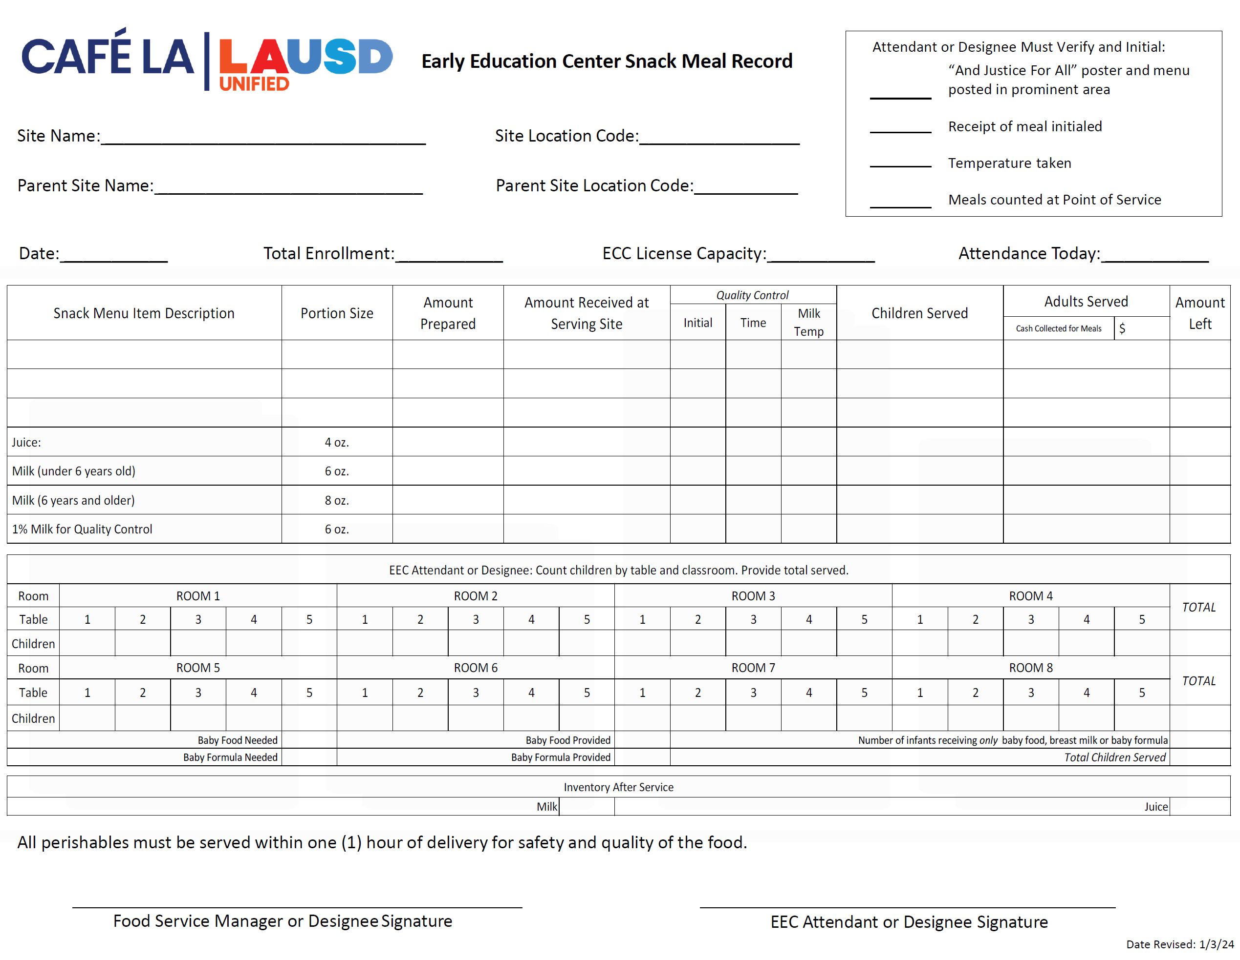
FSD Staff
Completes the header section
Lists menu items, portion size and quantities

Slide 62
EEC Attendant Snack Preparation
The EEC Attendant will receive the after-school snacks and complete the SNP After School Snack Meal Record.
Communicates with cafeteria manager the amount of students in attendance
Will take temperature of the milk, record on the meal record and immediately dispose of the carton used
EEC Attendant and/or Designee will verify and sign the SNP After School Snack Meal Record for accuracy
Snacks must be consumed on campus

Slide 63
EEC Attendant
Completes the compliance box in the header section by initialing each item

Slide 64
EEC Attendant
List amount of received snacks, and record the amount of children served per item
Ensure all temperatures are checked for quality control
Leftover items are recorded and returned to the cafeteria daily.

Slide 65
EEC Attendant
Record the number of children that receive a snack, per table, per classroom
Add room totals and record under Total Children Served
Sign and verify all is accurate on the Meal Record

Slide 66
EEC
Monitoring

Slide 67
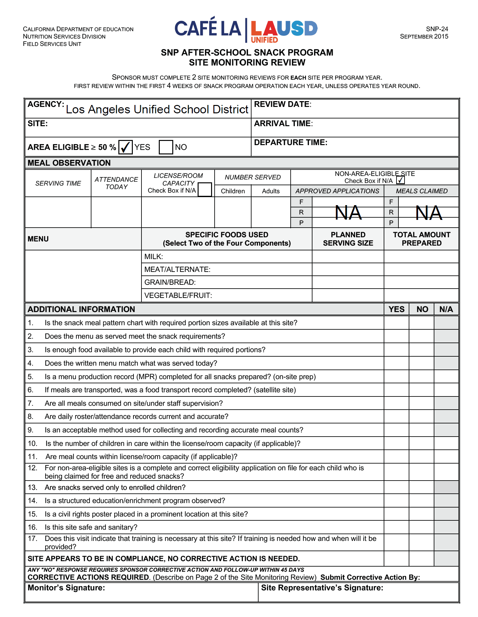
SNP Snack Site Monitoring Review
The AFSS/FSM will complete the form on the day of the monitoring.
Note: All site monitors are unannounced.

Slide 68
Successful Monitoring
The Area Food Services Supervisor (AFSS) is required to conduct the 1st site monitoring for SNP after-school snack. FSM should accompany the AFSS during the 1st monitoring. It is important to be compliant in each of the following areas:
  Collection and maintenance of records
  Meal service
  License requirements
  Health, safety and sanitation

Slide 69
Snack Monitoring Timeline
Monitoring is required to be completed 2 times per year, all are unannounced.
Monitoring | Completed by
First | October 2, 2025
Second | June 2026

Slide 70
Monitoring Report Retention
The Food Services Manager must retain the original Monitoring Reports and any corrective action documents for 3 years, plus the current school year.
The AFSS/FSM will provide a copy of all the monitoring documents to the appropriate Food Services Staff Aide.

Slide 71
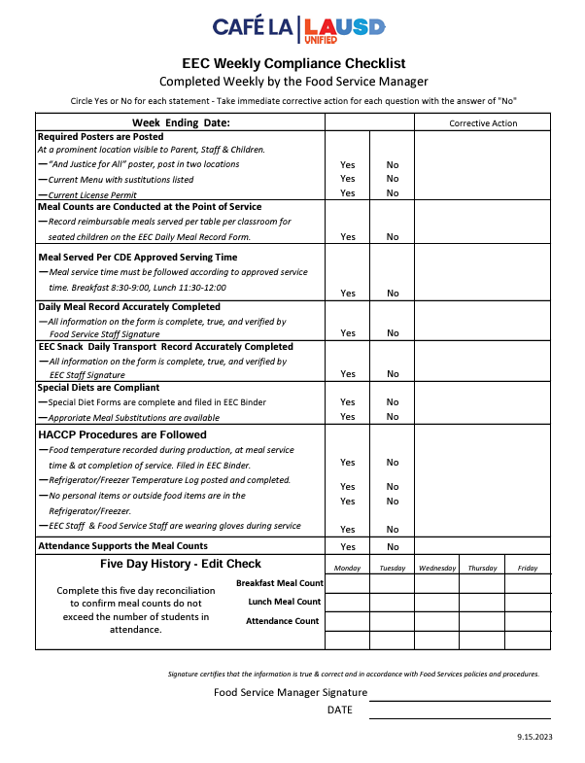
EEC Weekly Compliance Checklist
    The “EEC Weekly Compliance Checklist” assist in following CDE regulations.
      Food Service Manager will:
      Enter week ending date
      Circle yes or no for each statement
      Complete and document corrective actions
      Fill out the Five-Day History – Edit Check reconciliation
      Certify the findings, sign and date at bottom

Slide 72
Record
Keeping

Slide 73
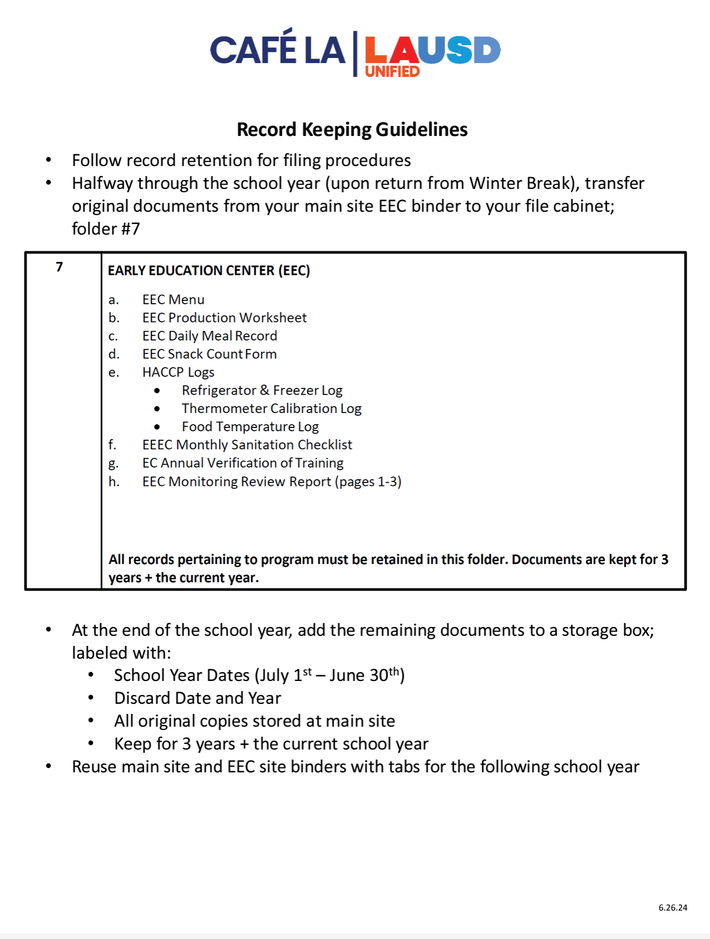
Record Keeping Guidelines
  Follow Record Keeping Guidelines for filing procedures.
  Guidelines can be found on page 2 of the EEC Binder Table of Contents on the Café LA website > EEC tab.

Slide 74
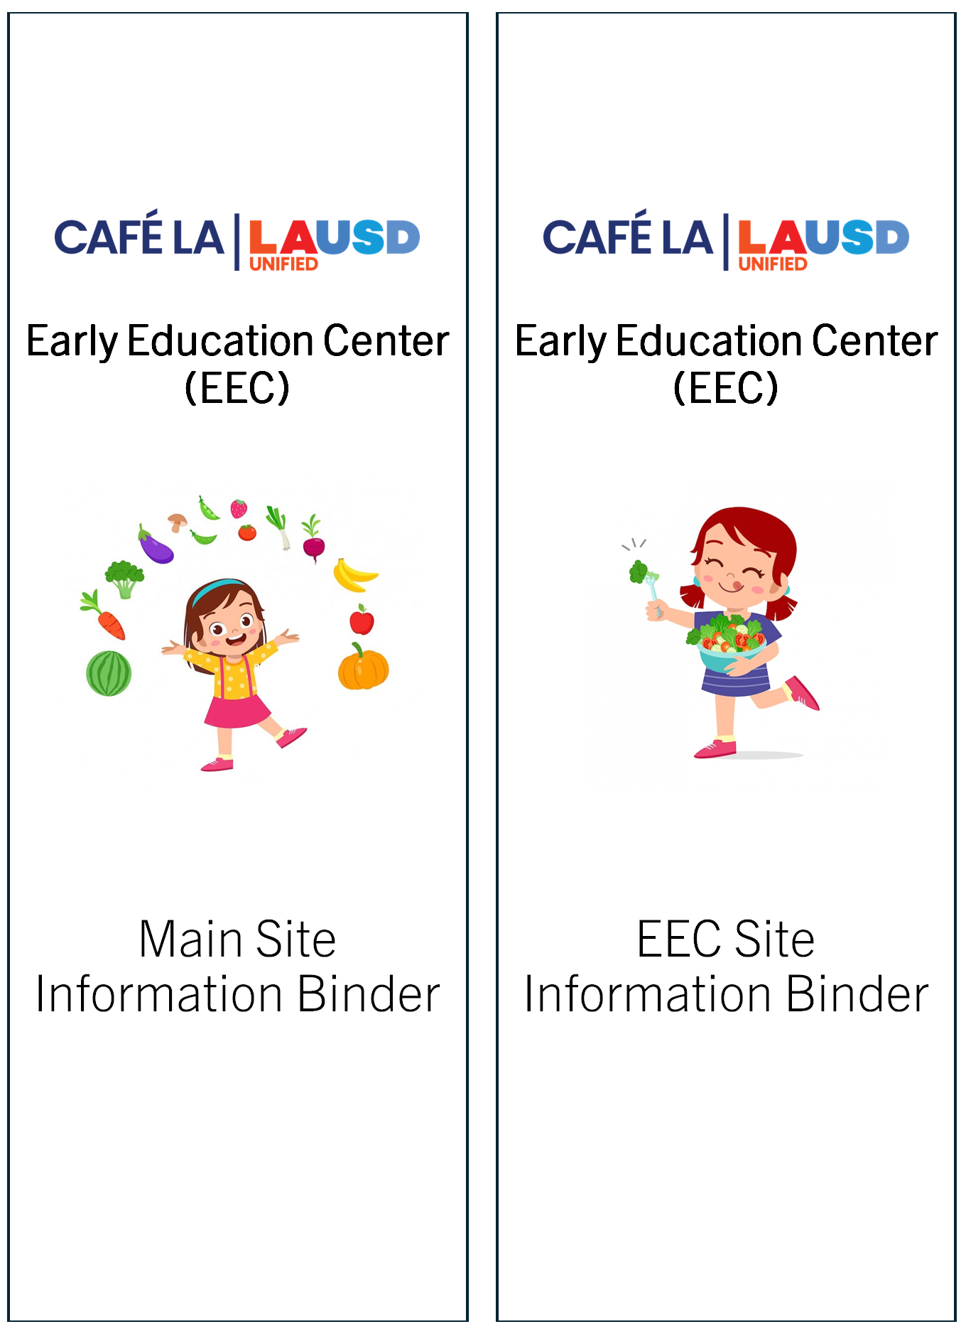
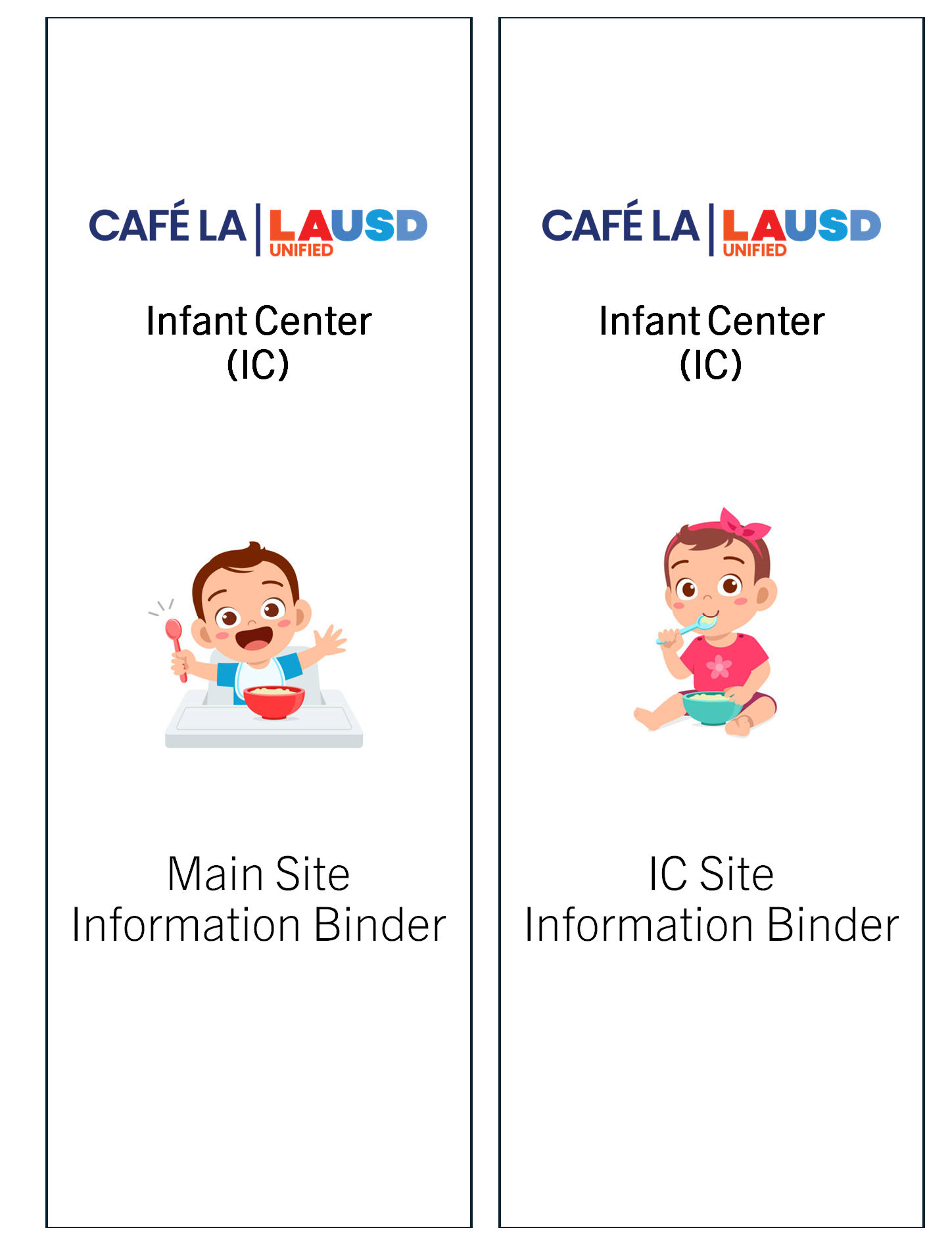
Main and EEC Site Information Binders
  Keep two binders of all EEC documents:
  Original copies completed and stored in the cafeteria
  Duplicate copies kept at the EEC site
  Maintain an organized system. The use of binder dividers and page protectors are highly recommended.
  Note: Infant Centers follow same procedures for record keeping as an Early Education Center.

Slide 75
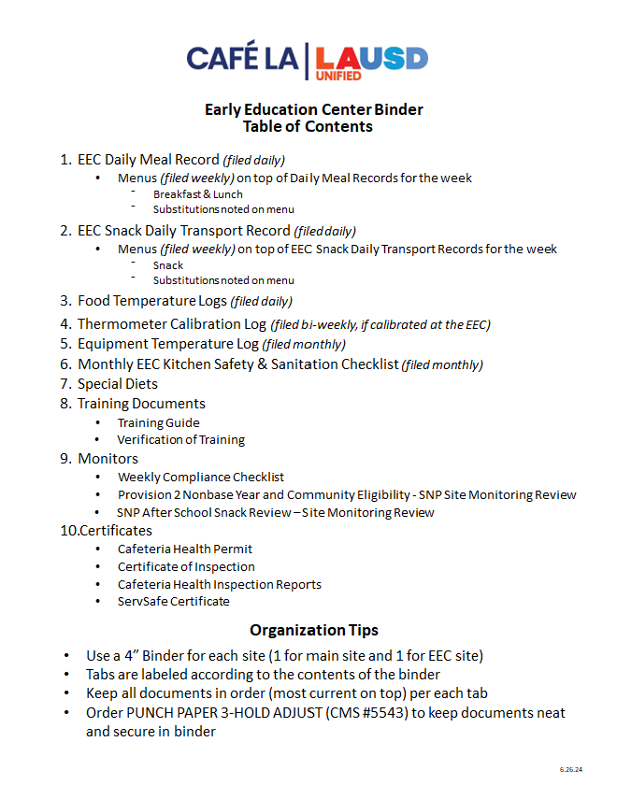
Table of Contents
  Follow the EEC Table of Contents to keep an organized binder for each the EEC Site binder and the Main Site binder.
  All Main Site documents are duplicated, and copies kept in the EEC Site binder
  There must be 10 tabs for each binder to align with the corresponding items in the Table of Contents

Slide 76

Main Cafeteria Site Information Binder
  Main Cafeteria Site Binder includes all original verified EEC documents used for all meal services at the EEC site.
      Binder is stored in an accessible location at the main cafeteria site
      Documents are kept onsite for 3 years plus the current year

Slide 77
1. Daily Meal Record
EEC Daily Meal Record, Menus for each week
2. Snack Meal Record
SNP After School Snack Meal Record, Menus for each week
3. Food Temperature Logs
Filed daily
4. Thermometer Calibration Logs
Filed bi-weekly, if calibrated at the EEC
5. Equipment Logs
Filed monthly

Slide 78
6. Sanitation Checklist
Monthly EEC Kitchen Safety Sanitation Checklist, filed monthly
7. Special Diets
List of students with special diets on file, each students individual Special Diets Form
8. Training Documents
Verification of Training, FS Staff Training Guide, EEC Staff Training Guide, Copy of the EEC Training slides (optional)
9. Monitors
Weekly Compliance Checklist, SNP Site Monitoring Review, SNP After School Snack Review
10. Certificates
Cafeteria Health Permit, Certificate of Inspection, Cafeteria Health Inspection Report, ServSafe Certificate

Slide 79

EEC Site Information Binder
  EEC Site Binder includes all photocopied verified EEC documents from the Main Cafeteria Site Information Binder.
      Binder is stored in an accessible location at the EEC site
      Documents are kept onsite at the EEC for 1 year plus the current year

Slide 80
Questions?
Thank you

